Slide 1

Professionalism
Louisiana Support Enforcement Association Training Conference
March 5, 2026
Justice Jay B. McCallum ^{© 2025, 2026}
Louisiana Supreme Court

Slide 2

You cannot be professional without being a leader.
Professionals must be capable of and willing to lead.
Leadership is a cornerstone of professionalism.

Slide 3
You cannot successfully do your job if you are not an effective leader.

Slide 4


“… for a living dog is better than a dead lion.” Ecclesiastes 9:4

Slide 5
LEADERSHIP MATTERS

Slide 6
“It is not necessary to do extraordinary things to get extraordinary results.” -Warren Buffett

Slide 7

YOU ARE NEVER NOT LEADING
Someone is always watching you.

Slide 8

Three Reasons Why Leadership Should Be Easy:

Slide 9
1. The people you lead want to be like you; in fact, they want to be you.

Slide 10
2. Leadership costs little.

Slide 11
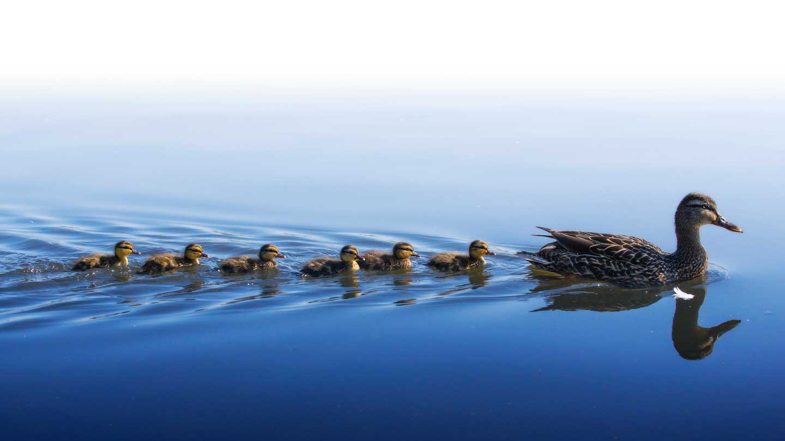
3. It requires less effort than you think; after all, it is LEADERSHIP, …

Slide 12

… not PUSHERSHIP.

Slide 13

Leaders Set An Example:
The people you lead want to be like you.
…

Slide 14
What does that look like?
…

Slide 15


Some only bloom in Autumn.
Not every flower blooms in Spring,

Slide 16
You are never too old or entrenched to become a better leader.

Slide 17
“It’s only when the tide goes out that you learn who has been swimming naked.”
Warren Buffett
Do not allow yourself to become exposed.

Slide 18
There may come a time to change the way you are doing things.
“Should you find yourself in a chronically leaking boat, energy devoted to changing vessels is likely to be more productive than energy devoted to patching leaks.”
Warren Buffett

Slide 19
Be willing to improve.

Slide 20
A horse that can count to ten is a remarkable horse – not a remarkable mathematician. You may be working hard when you just need to work smarter.

Slide 21






SIX PRINCIPLES TO BECOME AN EFFECTIVE (PROFESSIONAL) LEADER
I. The Principle of Movement
II. The Principle of Preparation
III. The Principle of nurture
IV. The Principle of delegation
V. The Principle of Reciprocity
VI. The Principle of Infusion

Slide 22
I. The Principle of Movement

Slide 23
This may be the foundation for all the other principles.

Slide 24

Every day you are either proceeding toward success or you are retreating toward failure.

Slide 25
Leadership is a destination and you must move to get there.

Slide 26
Everyone wants to arrive at some great destination, but there are few willing to take the steps to get there.

Slide 27

Everything you do ought to be a step in the direction of reaching your goals.

Slide 28

The most difficult part of any journey is the first step.

Slide 29
If you are having trouble starting at the beginning, start somewhere else.

Slide 30
II. The Principle of Preparation

Slide 31
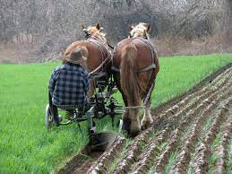
Leaders Plow Before They Plant and Plant Before They Pick

Slide 32
Leaders Set Goals and Every Step They Take Moves Them Closer

Slide 33
Being Average is Easy. Average Requires No Effort.
Average is a nice word for mediocre.

Slide 34
Most People Are Satisfied With Being Average.

Slide 35
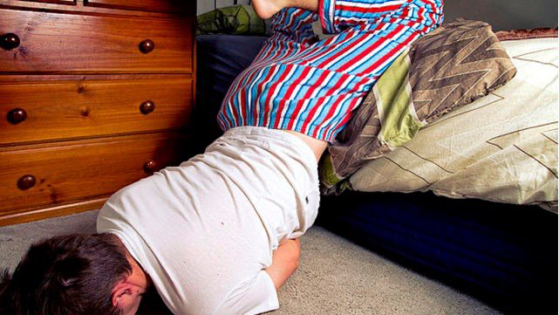

Slide 36
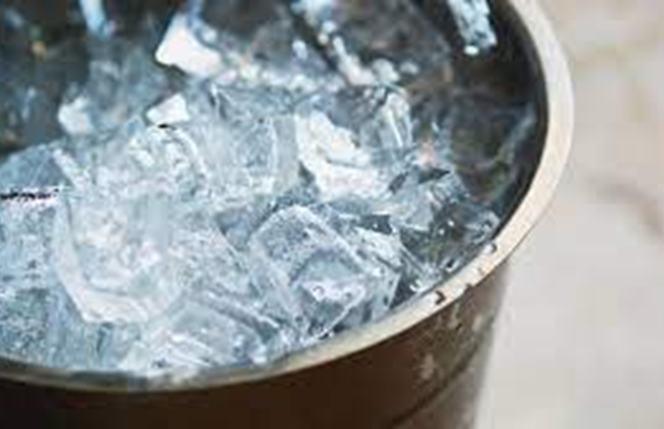
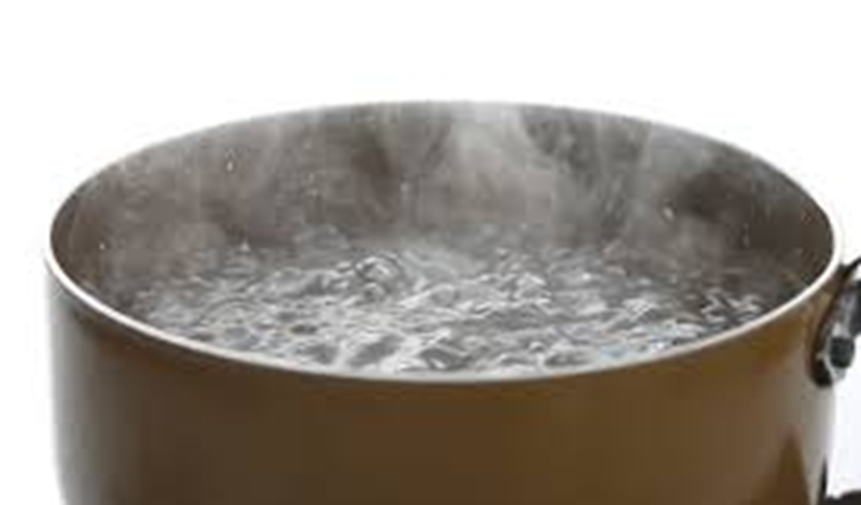

Slide 37
Leadership requires effort.
Allow me to introduce you to Aleksandr Karelin

Slide 38
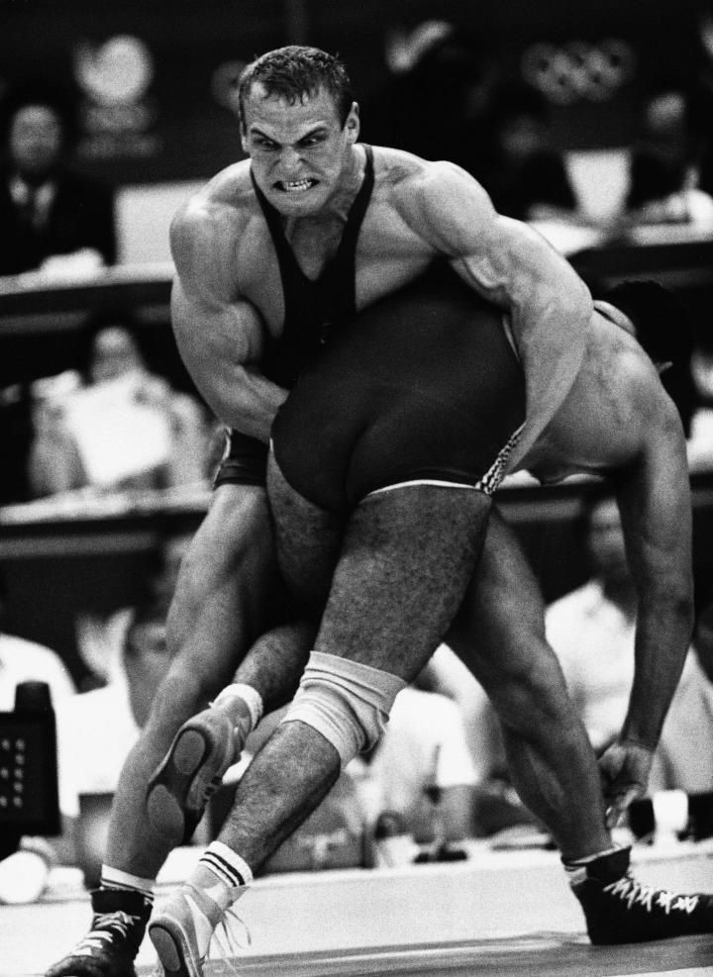

Slide 39
Do not practice until you get it right.

Slide 40
If you miss 99 free throws and finally make the 100th, you have practiced until you got it right.

Slide 41
“Practice until you cannot get it wrong.”
– Dan Orlovsky, ESPN
However, you have a 99% rate of failure.

Slide 42
III. The Principle of Nurture

Slide 43


Leaders nurture their strengths.
You should water your flowers and kill your weeds.

Slide 44
Weightlifters develop their strength, not their speed.

Slide 45
IV. The Principle of Delegation

Slide 46
Leaders Delegate

Slide 47
JETHRO’S ADVICE (EXODUS 18:19-23)
1. Be the Representative: Continue representing the people before God.
2. Delegate: Select capable, trustworthy, God-fearing men who hate dishonest gain.
3. Structure the Leadership: Appoint these men as officials over thousands, hundreds, fifties, and tens.
4. Train Them: Teach them God’s decrees and instructions, showing them the way to live.
5. Trust Them: Let them handle simple cases, bringing only difficult matters to Moses.

Slide 48
Do not fear the success of others.

Slide 49
Benefit from their achievements.

Slide 50
Never do anything that someone else will do for you.

Slide 51
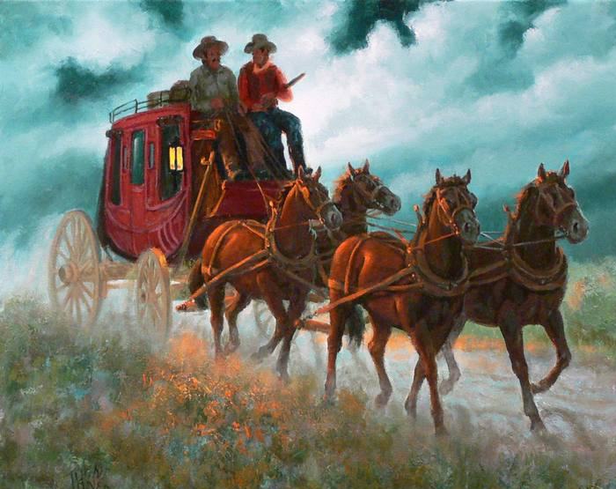
One horse can’t pull a stagecoach; it takes a team. Be willing to work with others. It is amazing how many people cannot delegate to others.

Slide 52

Micromanagers can never see the whole picture, they can only see one piece of the puzzle.

Slide 53
Others who have been doing a task may know a better way.
The Power of Asking

Slide 54
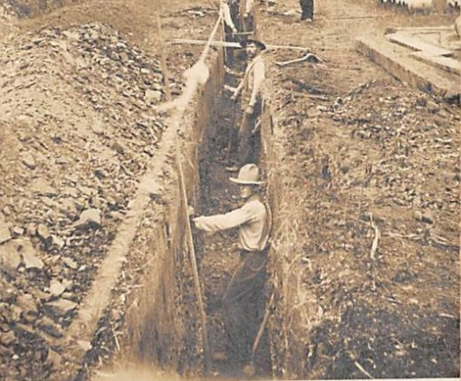


Slide 55
Do not be afraid to ask for help.
“I’ve never found anyone that didn’t want to help if I asked them for help.”
Steve Jobs

Slide 56
JAMES: 1:19
“Be quick to listen and slow to speak.”

Slide 57

Ask Questions.

Slide 58

Then Listen. -Matt Abrahams (Stanford University)

Slide 59
Asking does not diminish you in the eyes of the other person. To the contrary, it implicitly shows that person that you respect them, you trust them, and value and admire their skills, talents, and resources.

Slide 60
Asking good questions demonstrates you are willing to learn; demonstrates empathy; demonstrates your admiration of the person asked.

Slide 61
People will follow a leader who genuinely values their advice and assistance.

Slide 62
The people you lead crave your approbation.

Slide 63
V. The Principle of Reciprocity

Slide 64
Robert B. Cialdini, among others, devoted research to this principle.

Slide 65

People are more likely to help you if you have first helped them.

Slide 66
The Golden Rule …
is still the Gold Standard.
Matthew 7:12

Slide 67
That is why Hare Krishna give out flowers; after taking one, you feel obligated to donate.
You receive free address labels with fundraising appeals for the same reason.

Slide 68
The converse is also true.
People like it when you are obligated to them in some way.
Those who feel you owe them a favor are likely to be helpful and cooperative with you in your endeavors. They realize that helping you may put you in a position to do even more for them in the future.

Slide 69
VI. The Principle of Infusion

Slide 70

Competence in, Competence out!

Slide 71

“… Greater is He who is in you than he who is in the world.” 1 John 4:4

Slide 72
CONCLUSION
Be a living dog, not a dead lion.

