Slide 1
Café Applications
2026 LSEA Annual Conference

Slide 2
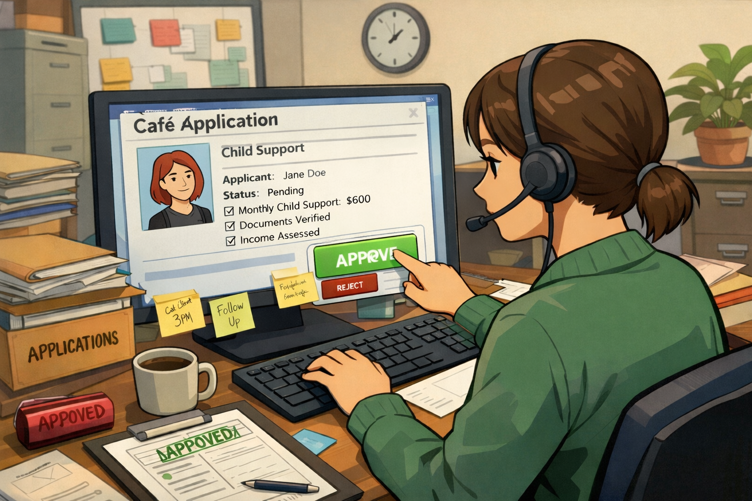
Where Do Applications Come From?
Application Examples
Paper
P000010011
Online Café
6042273266-01
IV-A Referral
A000009155
IV-E Referral
DCFS email box
Medicaid
M000009155

Slide 3
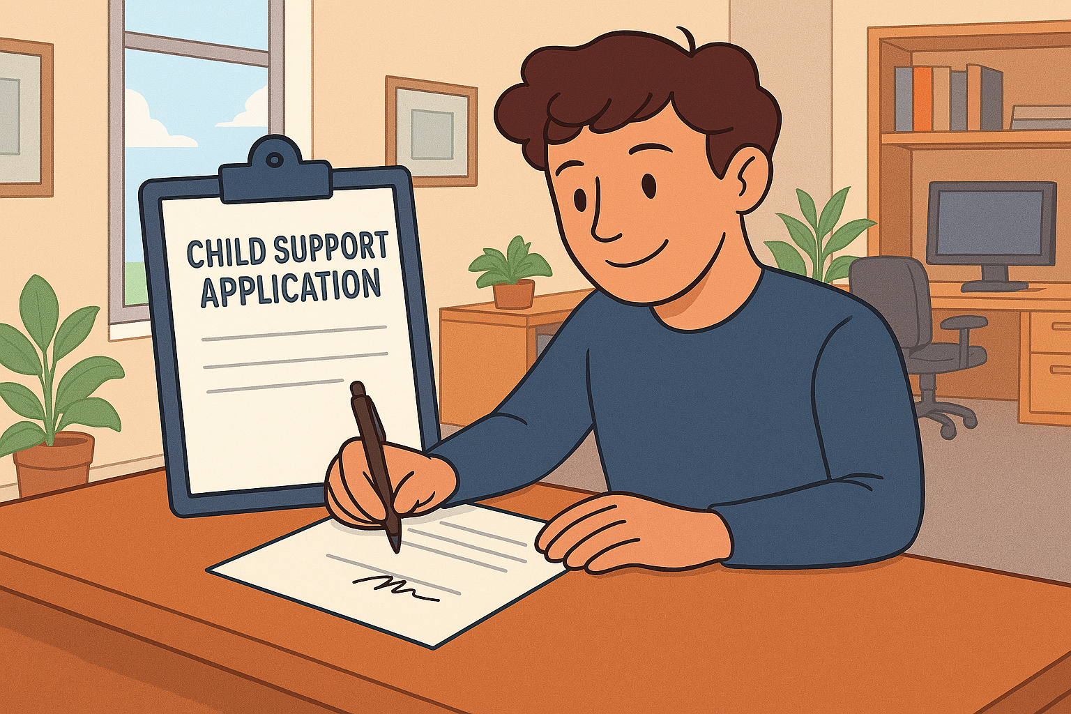
Step prior to clearing application
Investigate
AOP (FileNet)
Leers (LASESWEB)
Parties exist in LASES?
Application Signed?
Electronic-Cafe
Manual-Paper
4NCP-Referral
Notes:
4-NCP may not be under the correct document type. Try child’s name, NCP’s name or mother’s name/ss if CP is not the parent of the child.

Slide 4
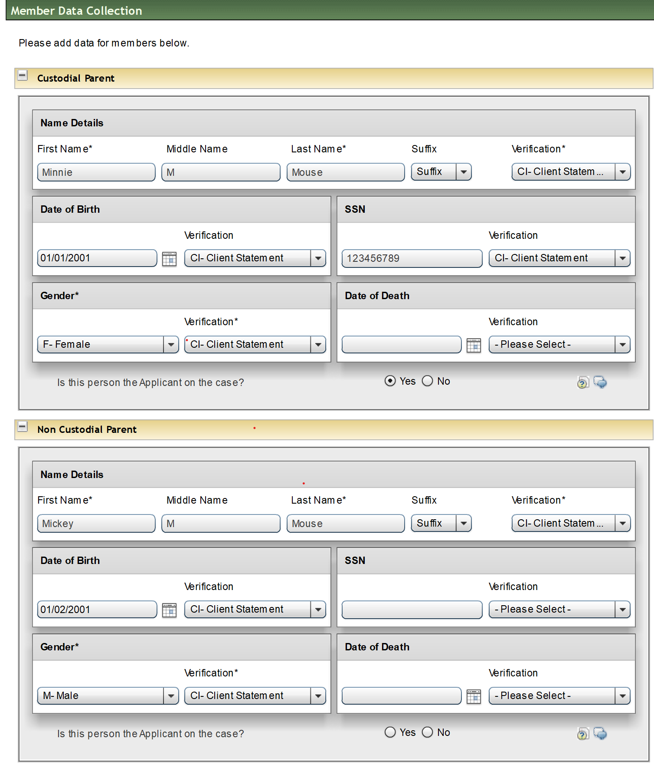

Missing info??
LASES
NASI-DOB & Name
FILENET
AOP
LEERS
Certificate Live Birth
LITE
LAMEDS
Supervisor

Slide 5
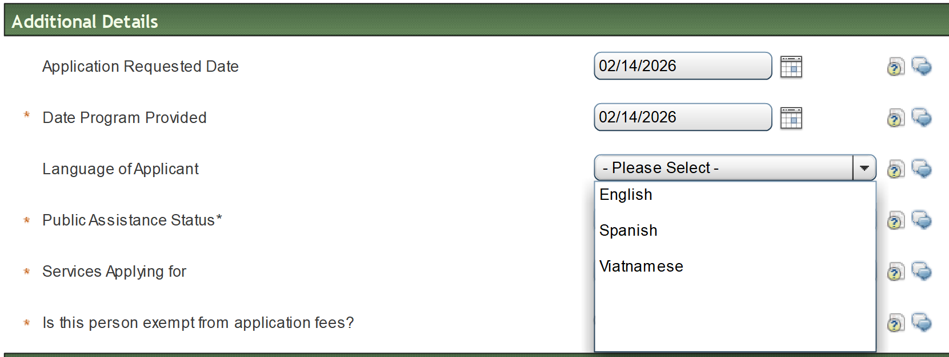
Language of Applicant
Review Online Application
Notes:
Language of Application
Leave Blank if information is not available. Not a required field

Slide 6
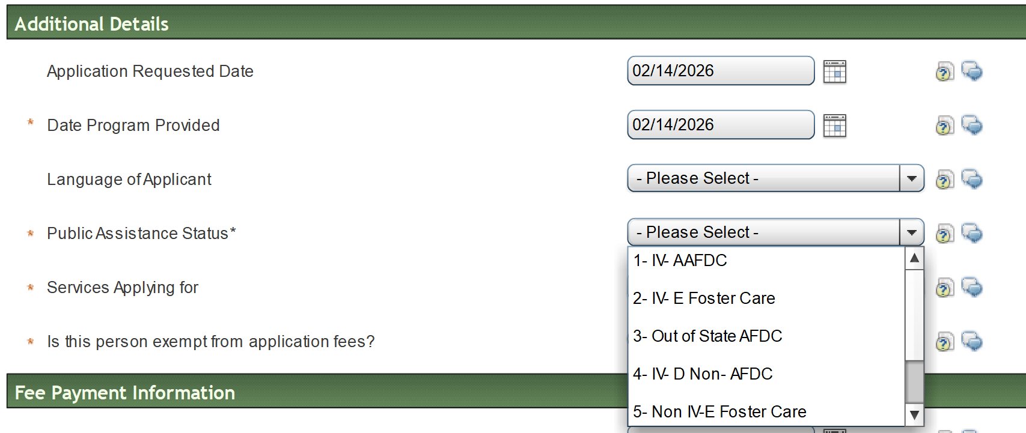
*Public Assistance Status
Notes:
Public Assistance Status-Required
Will prefill if:
IV-A referral
If applicant completes this section
Look at question below “ Does the client or any children who need child support receive FITAP, Medicaid or KCSP care?”
Mark Yes-Select 6-Medicaid

Slide 7
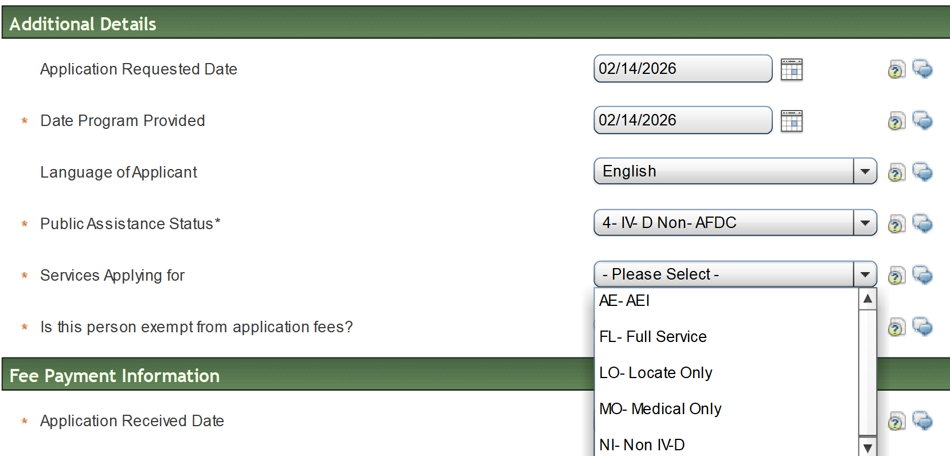
*Service Applying For
Types Services
Notes:
Policy: F-100-750
AE-AEI (If Louisiana is enforcing an order in a case in which no other state IV-D agency is involved and assets are located in another state, the Regional Office may request the state in which the asset is located to freeze and seize the asset under the Federal AEI provisions. The request may be sent to another state by electronic or other means.)

Slide 8
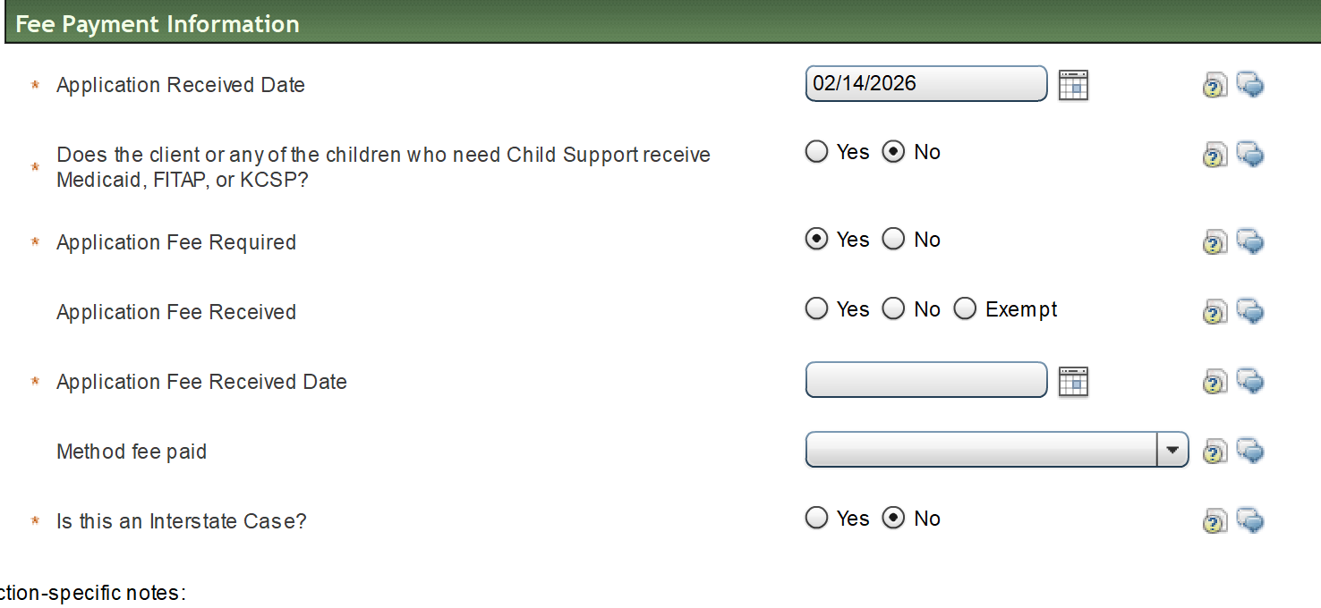
Policy G-140
Not
Required
Notes:
As of January 29, 2024, application fees will be covered by state funds until further notice (refer to E-2691).

Slide 9
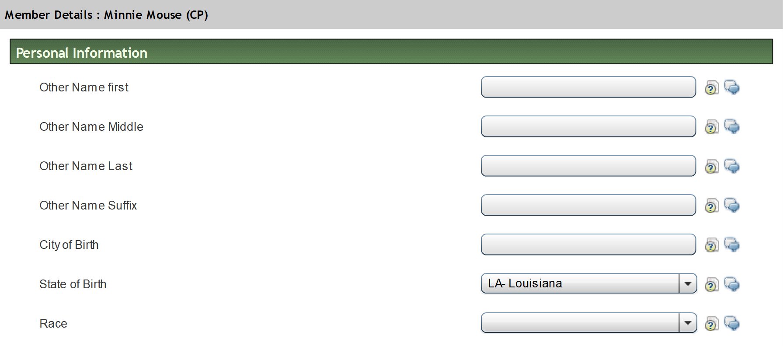
Member Details (CP)
Notes:
This does not push to LASES

Slide 10
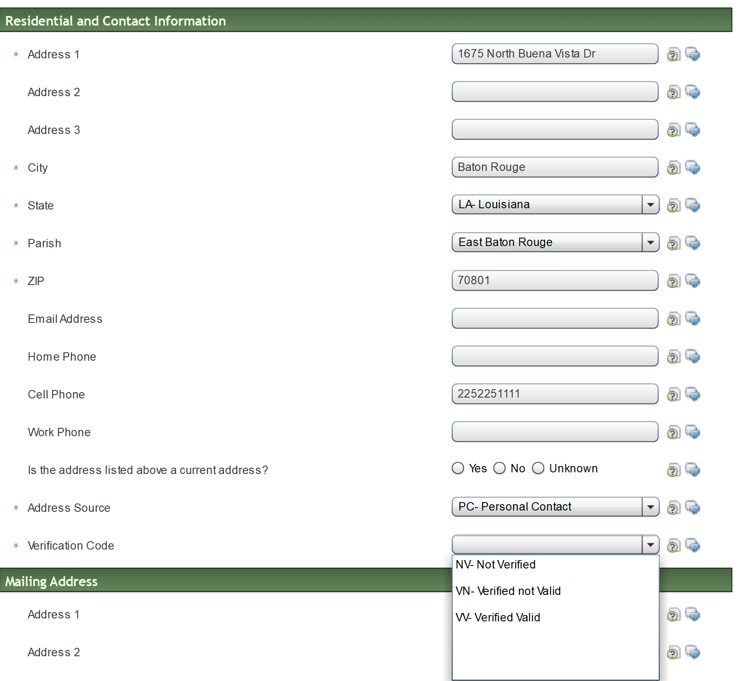
Residential info (CP)

Slide 11
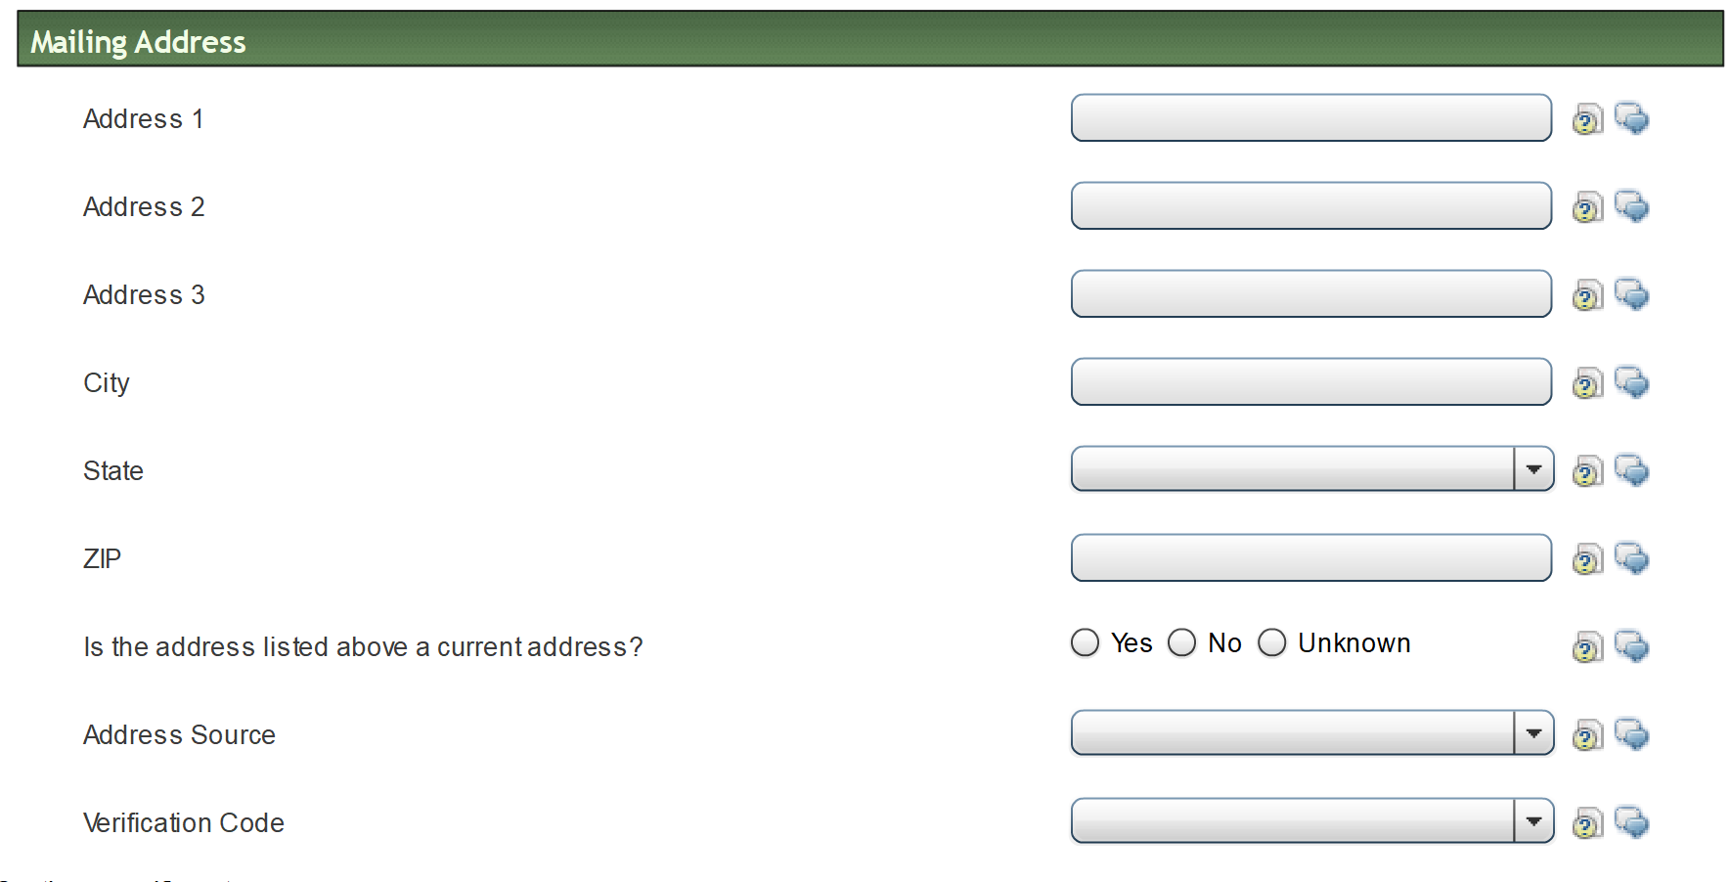

Mailing address (CP)
If mailing address is blank, where is the appointment letter going?
Notes:
If CP exist in LASES, the old address will remain in LASES. Therefore, if an appointment is needed, it will go to the old address.

Slide 12
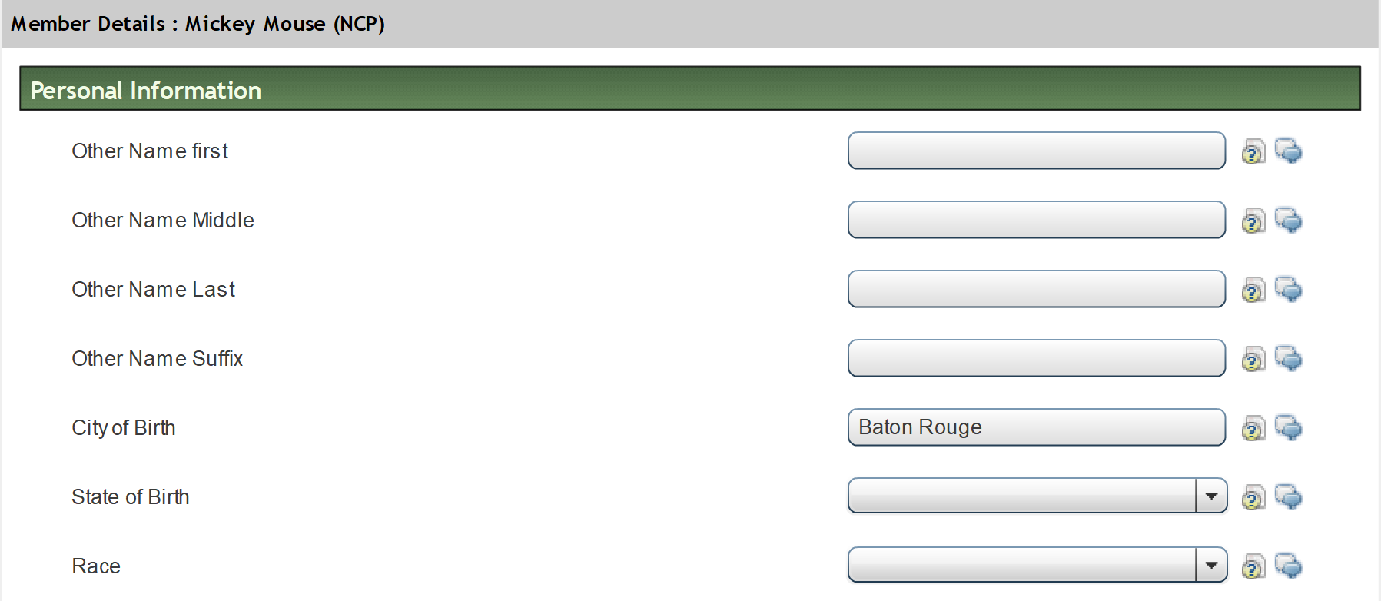
Member Details (NCP)
Notes:
This does not push to LASES

Slide 13
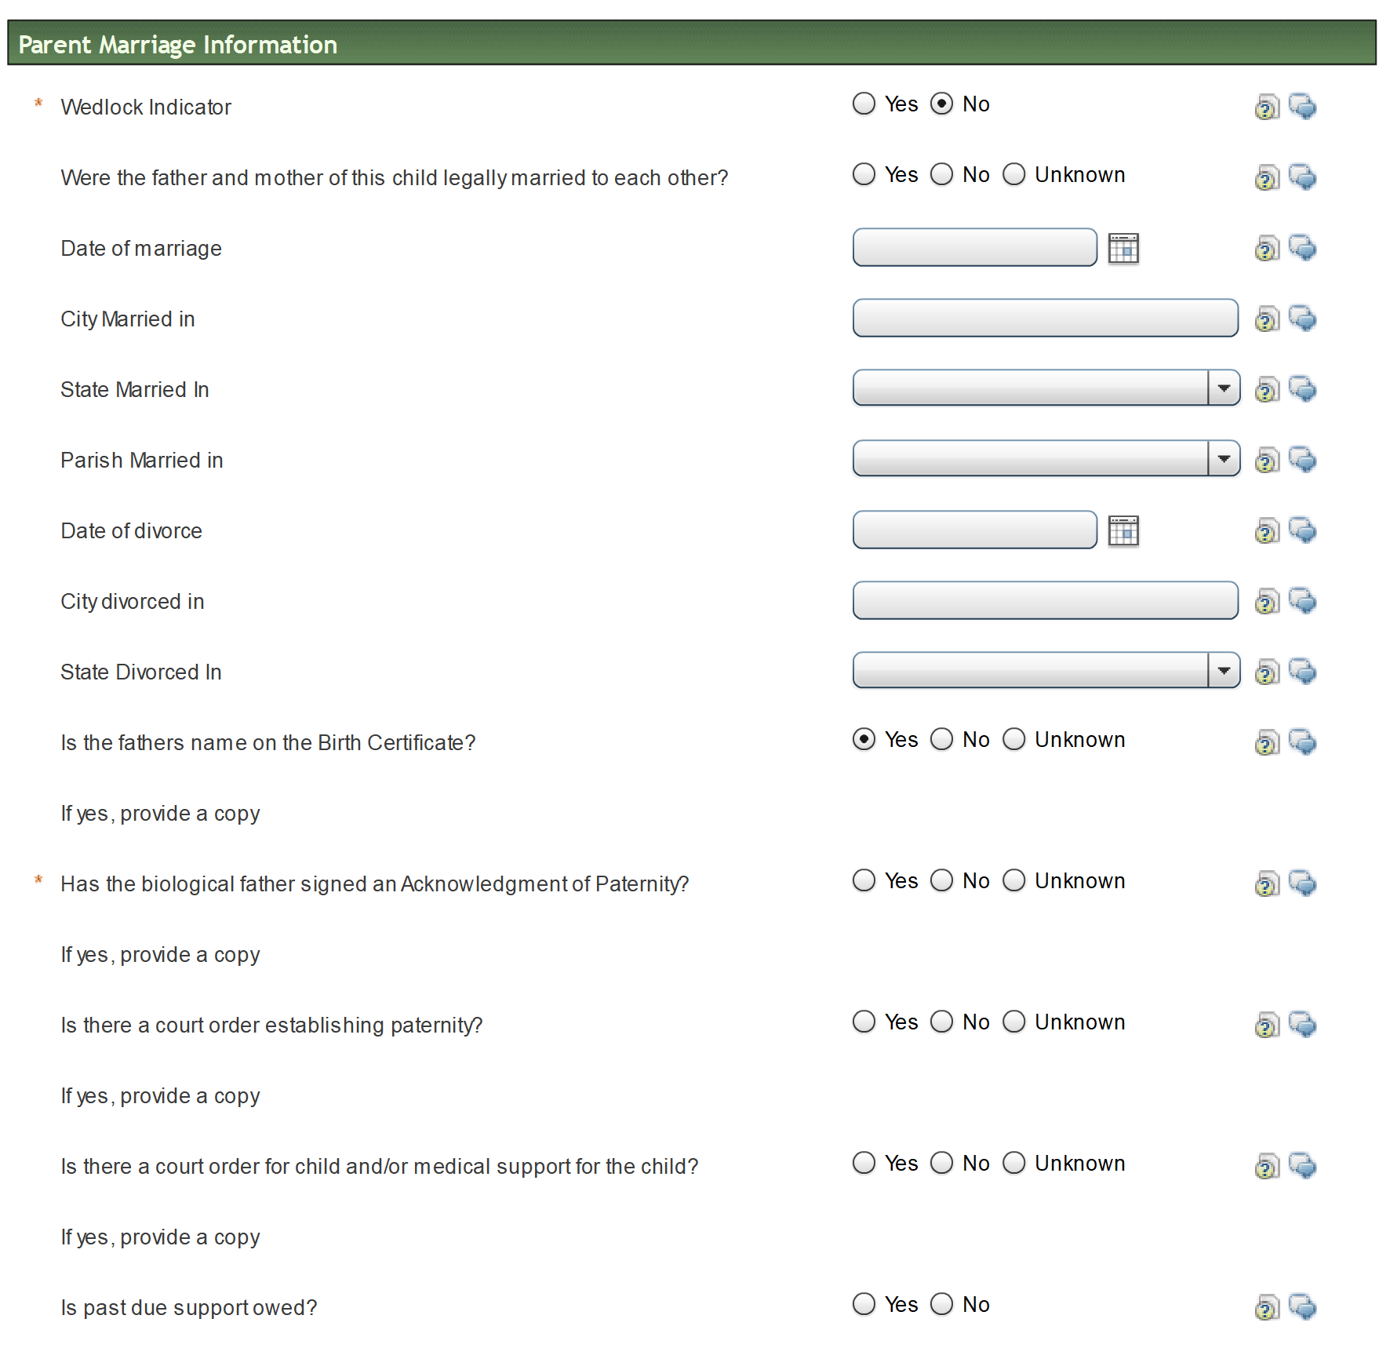
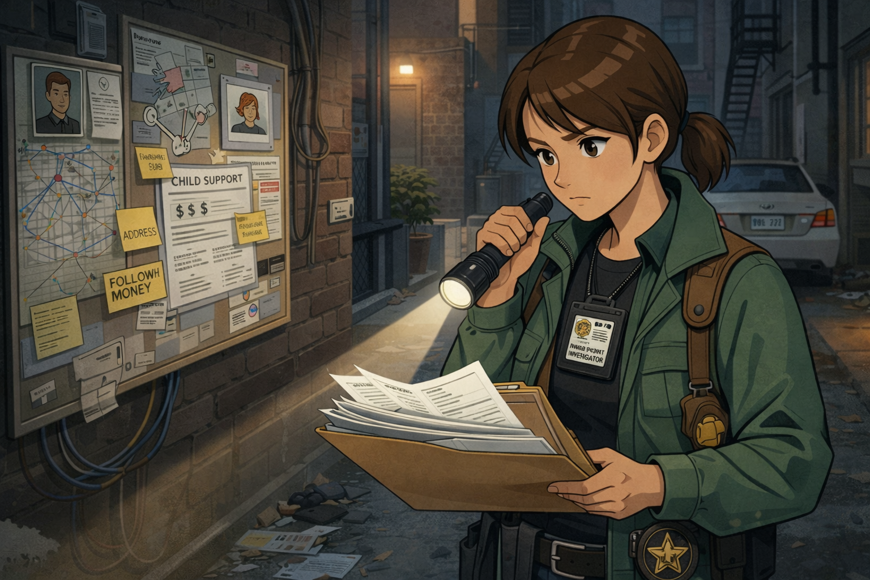
Minor Child Parent Marriage Information
*REQUIRED
Wedlock
Did bio father sign Ack?
Notes:
Did you pull the AOP from FileNet?
Is there an Order?

Slide 14
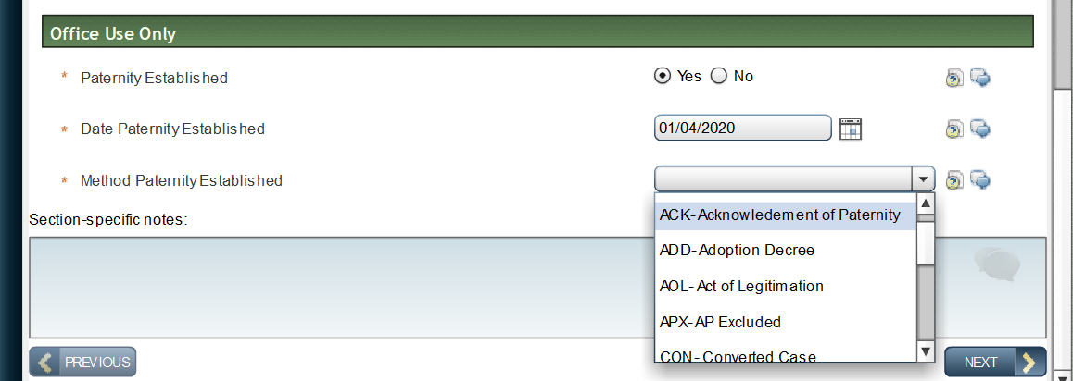
Office Use Only

Slide 15
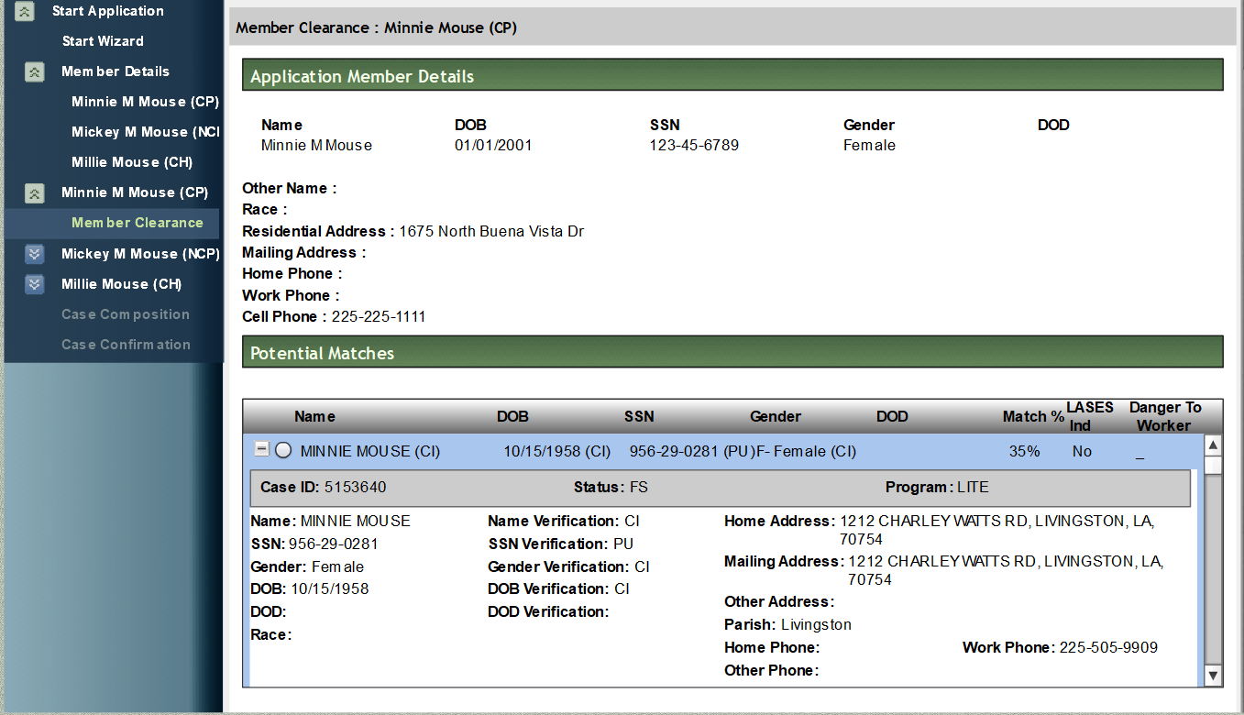
Member Clearance (CP)
8/17/1999

Slide 16

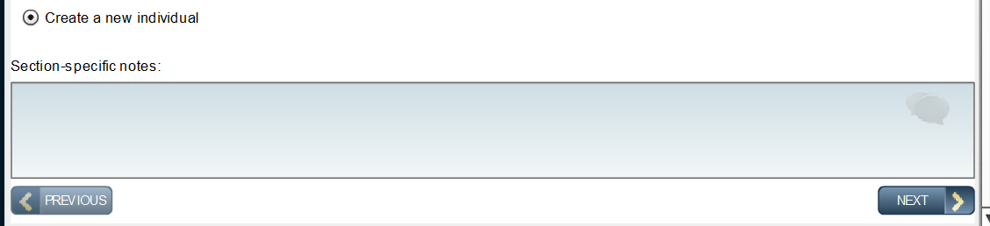
Member Clearance (CP)
No Match “Select” Create New Individual
Notes:
No match-Create a new individual

Slide 17
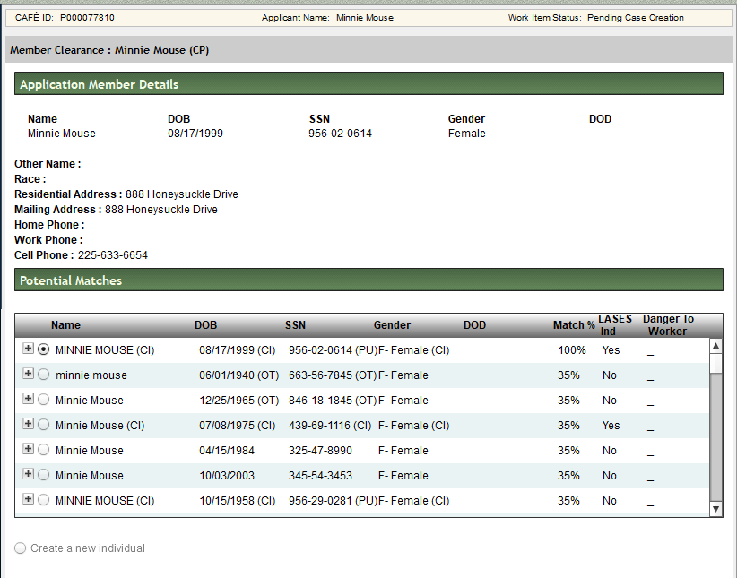
Member Clearance (CP)
Notes:
Match in LASES

Slide 18
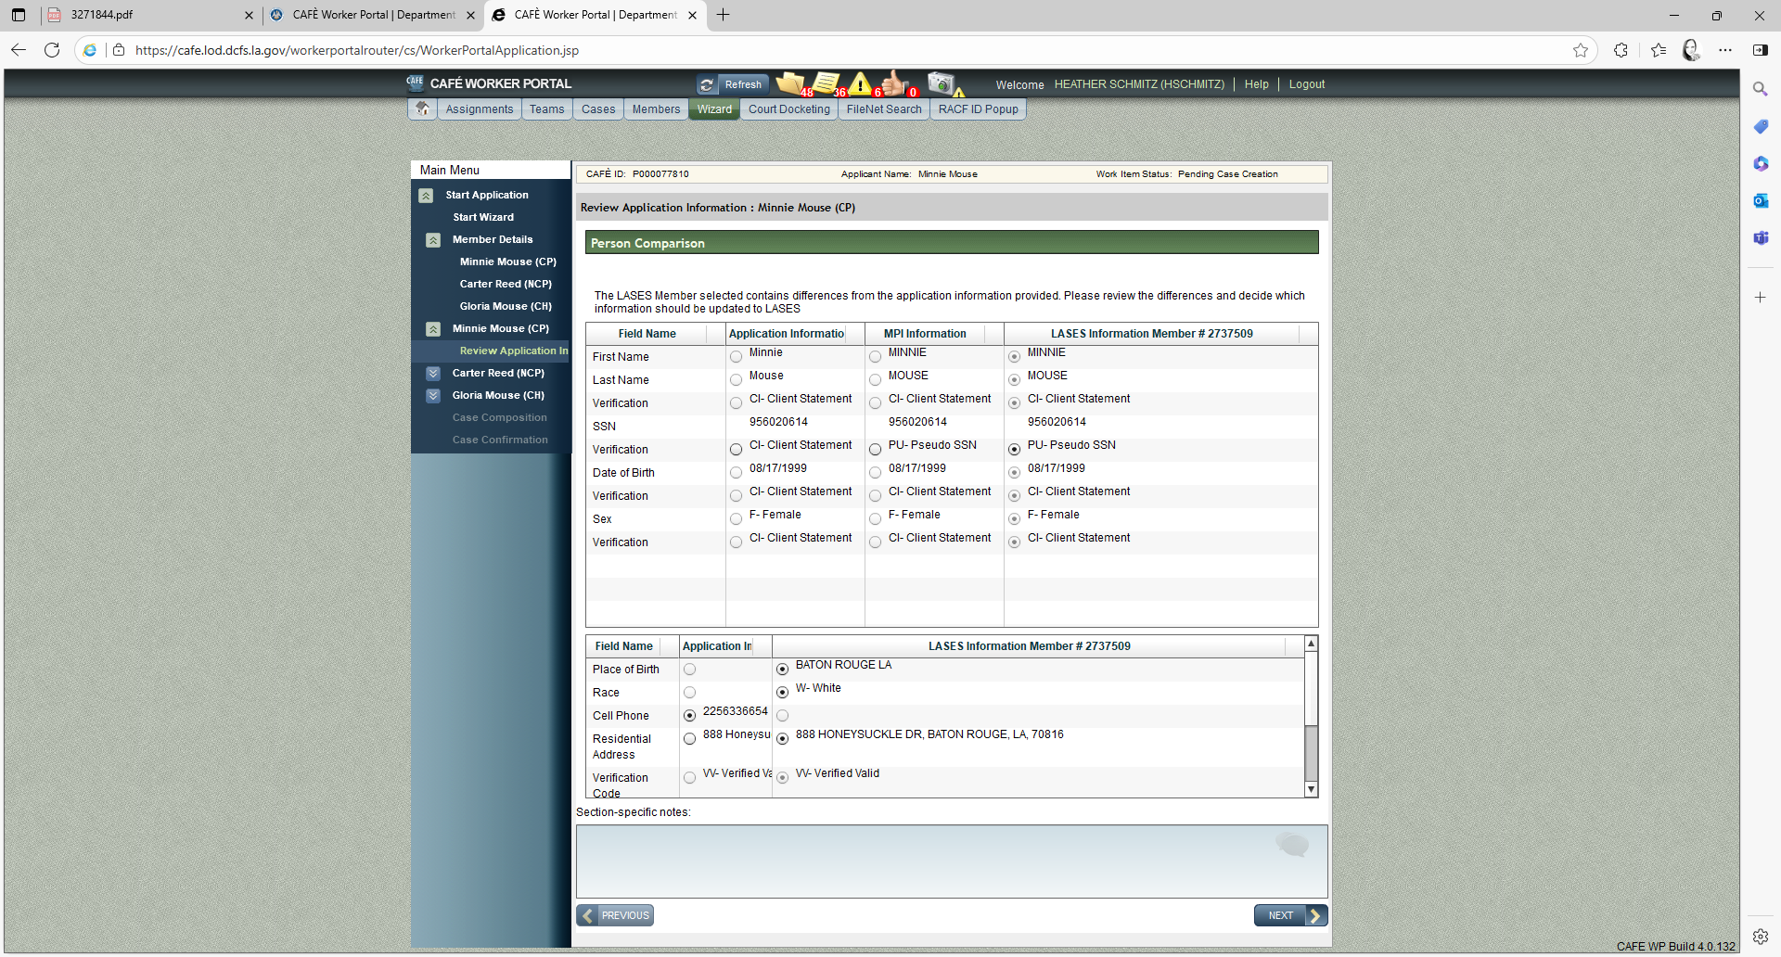
PERSON COMPARISON
Notes:
This compares the application/MCI and LASES information if applicable

Slide 19
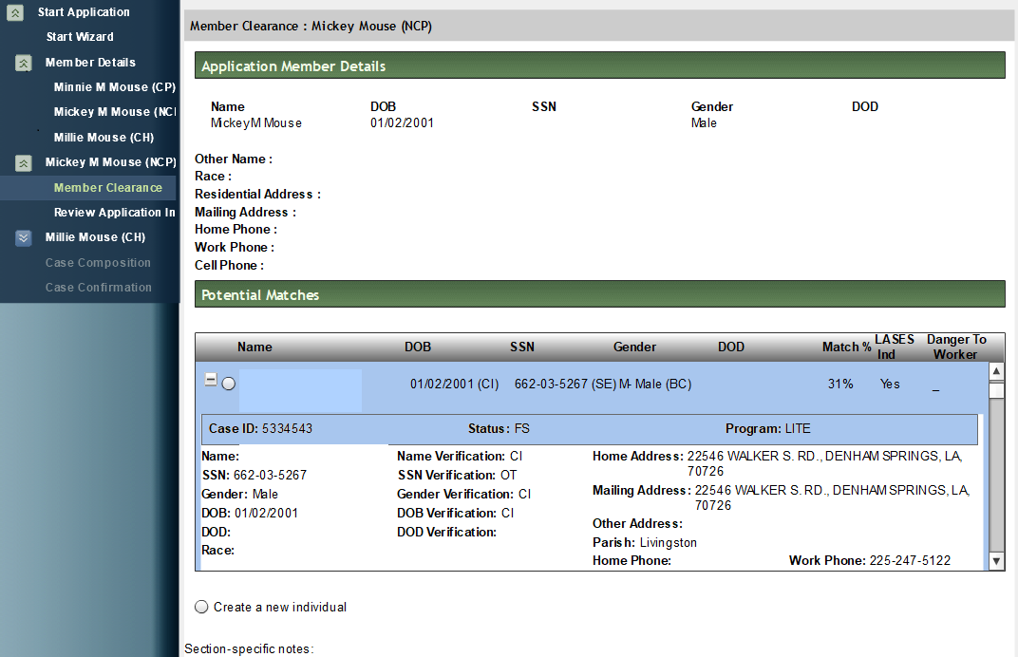
Member Clearance (NCP)
Mickey Mouse
999-99-9999
999-99-9999

Slide 20
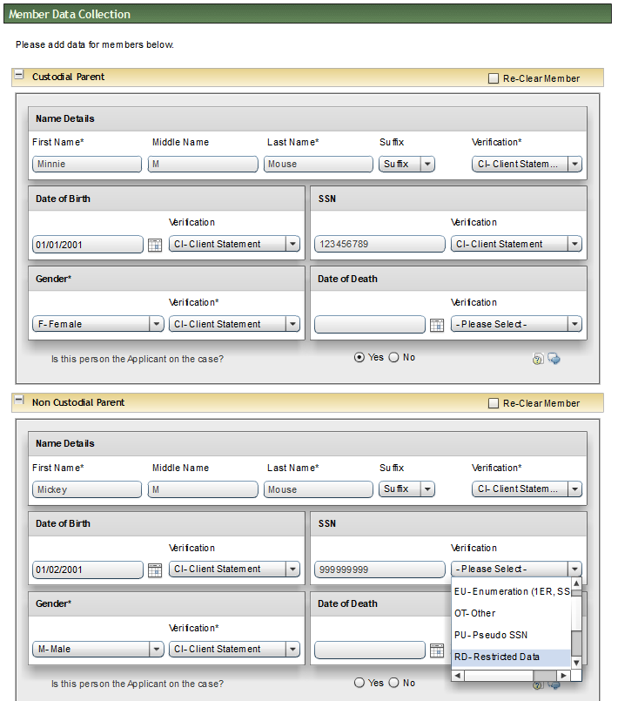
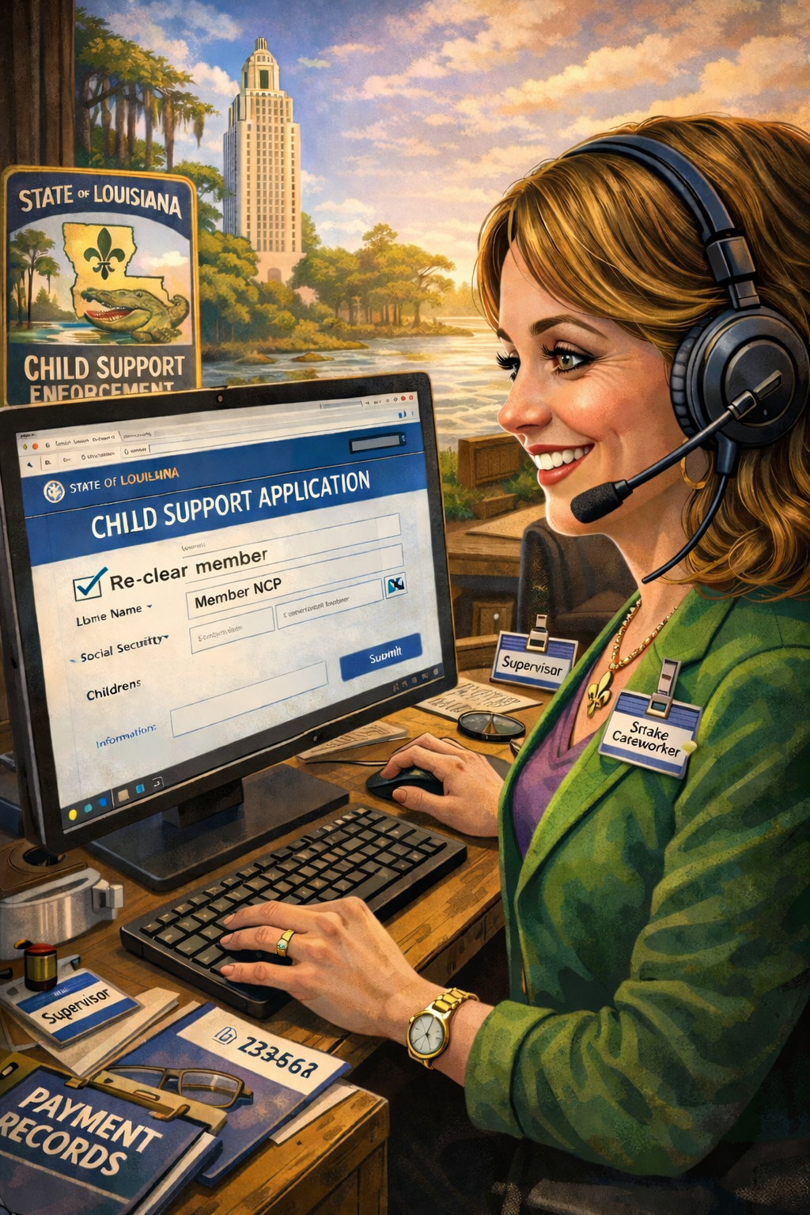
Member Data Collection
Re-Clear-NCP
Add SS#
Select Verification
Restricted Data

Slide 21
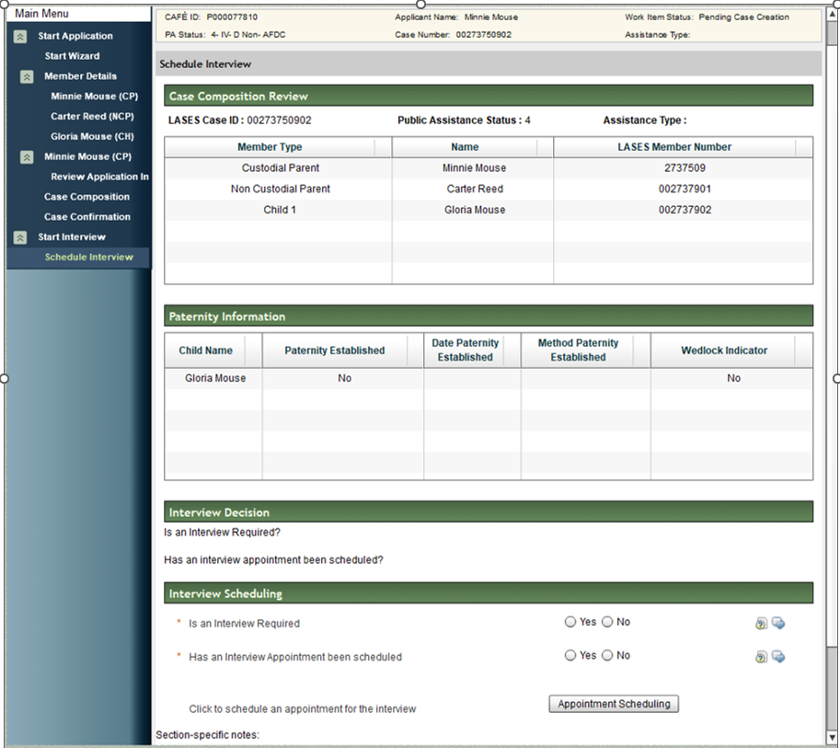
Case Composition review

Slide 22

Interview? yes or no!
G-168 Required Document
Can you locate this information without the applicant??
Application
IV-A Referral-4NCP (FileNet)
Online Application (Café-PDF, FileNet)
Birth Certificate (LEERS, FileNet)
Child Support Order (Clerk Connect)
Paternity Affidavit
Paternity Not Established
Income Verification (Work#, LWC, FPLS, LASES-INSE)
Proof of Expenses (Phone Call-expenses?)
Arrears Affidavit (Civil order?)
Beneficial But Not Essential
Driver License
State Issued ID
Marriage License
Divorce Decree
Notes:
Application:
Birth Certificate: If born in LA, you can use the certificate of live birth
CSE must attempt to obtain a birth record when the record is not in the Paternity Acknowledgement Portal, in * FileNet, ** or the CP is unable to provide a copy. If the minor child(ren) were born in another state, use a Transmittal #3 to request the other state’s assistance in obtaining the birth record or request the record using steps in policy G-280. If the birth record cannot be located after following the steps in policy G-280, the CP’s assistance may be required.
See Policy C-140

Slide 23
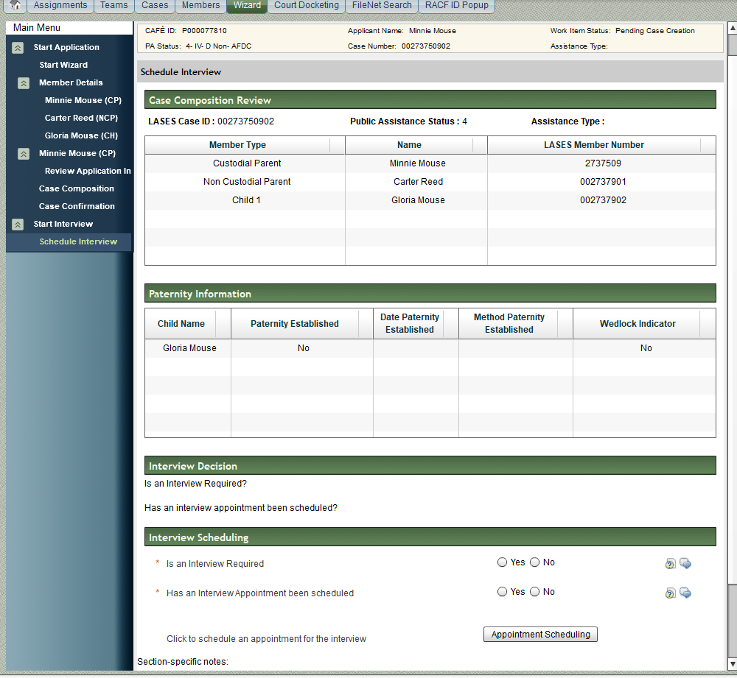

Case Confirmation
Complete
Is an interview Required?
If no, select: NO
Click Case Composition
Work Status: Complete

Slide 24

Case Confirmation
Pending interview
Is an interview Required?
If Yes, select: YES
Click-Appointment Scheduling
Schedule LASESWEB
Has an Interview Appointment been scheduled? YES
Work Status: Pending Interview

Slide 25
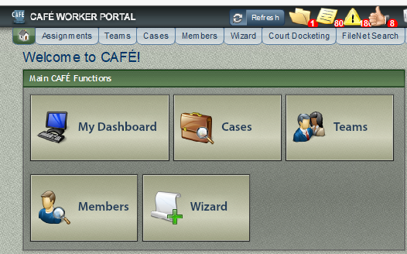
TIDBITS
MY DASHBOARD VS ICONS
Duplicate SS#
Duplicate application w/same NCP, different children
CALO, if it is an IVA referral, case will be “pending”, use LASESWeb to make your CALO
Be sure all documents are linked to the CP/NCP/Child(ren) member, ss# and case#
Notes:
If the CP is not the parent, be sure to link the AOP/BC to the mother/father. You will only be able to link by ss and member ID for this person

