Slide 1
Child Support Enforcement Performance Audit
March 4, 2026

Slide 2
What is the Louisiana Legislative Auditor’s Office?
LLA Mission - To foster accountability and transparency in Louisiana government by providing the Legislature and others with audit services, fiscal advice, and other useful information.
Better Information, Better Louisiana

Slide 3
LLA Sections
Financial Audit
Investigative Audit
Advisory Services
IT Audits
Recovery Audit
Performance Audit

Slide 4

Who does LLA audit?
Three Branches of Government:
Legislative
Executive
Judicial
LLA is a part of the Legislative Branch
LLA audits the Executive Branch, made up of state agencies, including DCFS

Slide 5
What is Performance Auditing?
Performance audits provide objective analysis to assist those charged with governance and oversight to
improve program performance,
reduce costs,
facilitate decision making, and
contribute to public accountability.

Slide 6
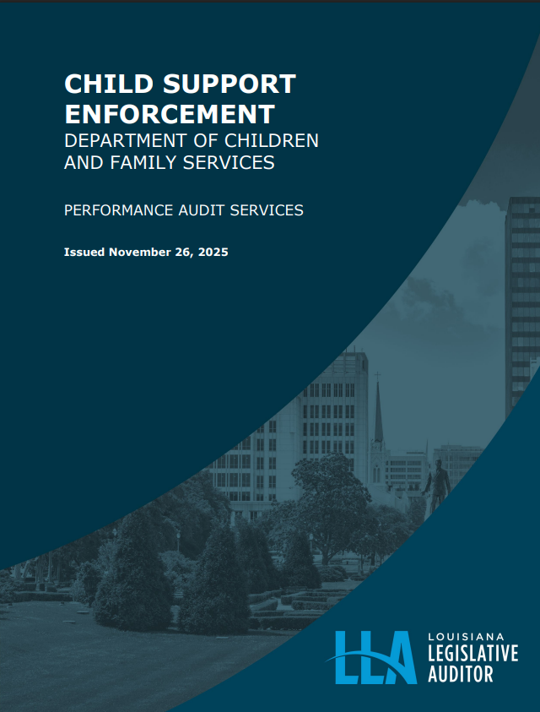
Child Support Enforcement Audit
Issued November 26, 2025
Two audit objectives:
To provide information about Louisiana’s Child Support Enforcement program and compare it to other states.
To evaluate whether DCFS ensures compliance with, assesses effectiveness of, and uses results from its case review process to improve overall CSE performance.

Slide 7
Audit Results
The number of child support cases in Louisiana decreased by 36,307 (14.1%), from 258,357 in 2020 to 222,050 in 2024.
This aligns with the national trend (11.8%).

Slide 8
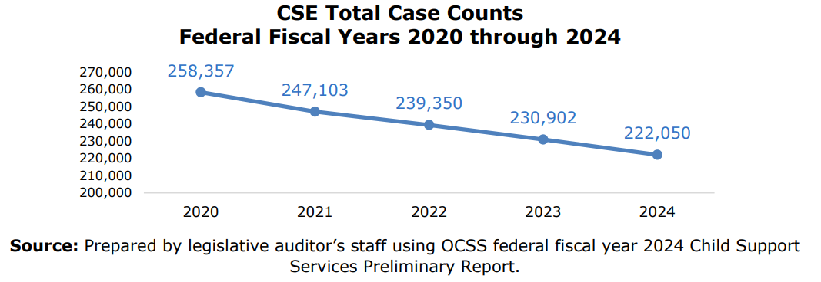
Audit Results

Slide 9
Audit Results
According to DCFS, the decrease in cases is due to reduced participation in federal assistance programs, specifically:
Temporary Assistance for Needy Families (TANF), and
a decrease in Medicaid referrals.
Notes:
Nationally, TANF participation has decreased 63.0%, and in Louisiana 26%

Slide 10
Audit Recommendation
Recommendation 1: DCFS should work with LDH to ensure that all eligible Medicaid cases are appropriately referred to DCFS.

Slide 11
DCFS Response Recommendation 1
Coordinating with LDH to improve Medicaid referral accuracy and timeliness Implementing necessary procedural and system enhancements Strengthening interagency referral exchange to ensure federal compliance Target completion: July 1, 2026 (full implementation may extend beyond)
Notes:
Response #1
DCFS is coordinating with Louisiana Department of Health (LDH), the state Medicaid agency, to ensure compliance with federal referral requirements by improving the accuracy and completeness of Medicaid referrals. DCFS will also implement any necessary procedural or system adjustments to support timely and accurate referral exchange between the agencies. The goal is to complete this work by July 1, 2026, though full implementation may extend beyond that date.

Slide 12
Audit Results
DCFS increased the percentage of current child support collected from 52.3% to 55.8% from 2020 to 2024.
However, Louisiana ranked 52nd out of 54 states and territories in the collection of current child support and 47th out of 54 states and territories in the collection of past-due child support in 2024.
Overall, DCFS collected and distributed $2.2 billion in child support payments during 2020 through 2024.

Slide 13
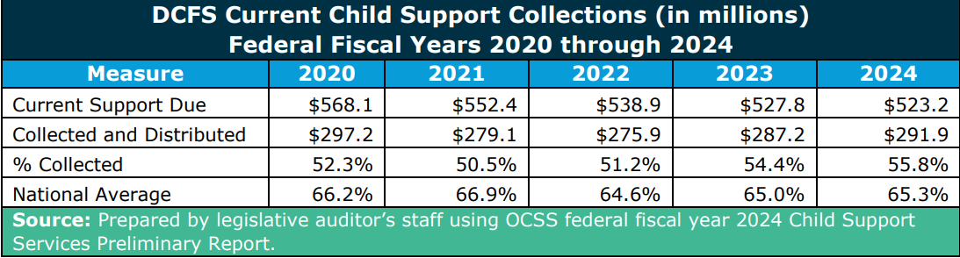
Audit Results

Slide 14
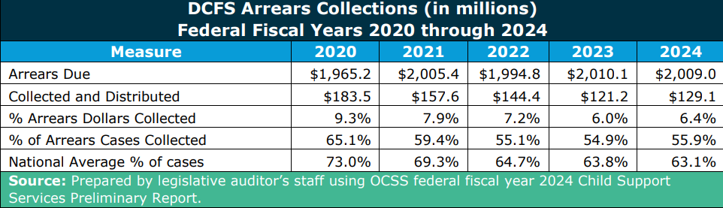
Audit Results

Slide 15
Audit Results
Challenges in collecting child support in Louisiana:
High poverty rate and low median household income. In Louisiana, the poverty rate is 18.9%, while the national rate is 12.4%. The state’s median household income is low at $60,023, while the national median is $78,538.
The amount of support owed is higher than other states, partly due to mandatory minimum child support amounts that existed until 2024. Prior to 2024, Louisiana law set a mandatory minimum child support award of $100 per month, regardless of income.

Slide 16
Audit Recommendation
Recommendation 2: DCFS should explore other practices to increase child support collections.

Slide 17
DCFS Response Recommendation 2
Pursuing legislation to require insurers to verify child support arrears before issuing settlement payments Reviewing internal policies to remove enforcement barriers Exploring enforcement tools: OCSS Insurance Match – Nationwide insurance payment matching FAST Levy Program – Electronic interstate levy processing to accelerate collections
Notes:
Response #2
DCFS is seeking legislation, as recommended in the report, that would require insurance companies to check whether a parent owes past-due child support before issuing a settlement payment. DCFS is also reviewing policies to remove barriers to enforcement and is looking at expanding current tools to include the OCSS Insurance Match, which would allow us to match additional types of insurance payments nationwide, and the Federally Assisted State Transmitted (FAST) Levy Program, which would let us send levy notices electronically to financial institutions in any state to speed up collections.

Slide 18
Audit Results
DCFS intercepted an average of $8.3 million per year in insurance claims for delinquent noncustodial parents during 2021 through 2025.
DCFS could potentially increase the amount of arrears collected via insurance intercepts if insurance companies that operate in Louisiana were required to share insurance claims data.

Slide 19
Audit Results
Total arrears due in Louisiana in 2024 was $2.0 billion. DCFS collected an average of 7.4% of total arrears due during 2020 through 2024.
Currently, at least 12 states have laws that require insurance companies to share claims data so that the child support agency is able to identify and intercept claims for noncustodial parents with past-due child support.
Notes:
Washington State found that states increased collections by 50% to 350% by requiring insurance companies to report insurance claims. In Washington, collections more than doubled and in Colorado, tripled.

Slide 20
Audit Recommendations
Matter for Legislative Consideration: The legislature may wish to consider requiring that insurance companies share claims data so that DCFS can identify and intercept claims for noncustodial parents with past-due child support.

Slide 21
Audit Results
In accordance with law, DCFS retained $70.9 million in child support payments during 2021 through 2025 to reimburse federal and state governments for TANF cash assistance, Foster Care, and Medicaid programs.
Federal law allows states to “pass through” a portion of the child support payments retained by the state to TANF recipients. Louisiana does not currently pass through child support payments.
52.0% of states pass through some portion of child support to families participating in TANF, such as a dollar amount per child or a percentage of the child support payment received.

Slide 22
Audit Results
DCFS improved cost effectiveness in 2024 and ranked 24th out of 54 states and territories for cost effectiveness that year. For every $1 DCFS spent on the program, it collected $4.51 in child support.
DCFS’s CSE expenditures increased by $14.1 million (16.3%), from $86.4 million in 2022 to $100.5 million in 2025 due, in part, to increased information technology and personnel costs.
Notes:
2024 LA = $4.51; US average = $4.24

Slide 23
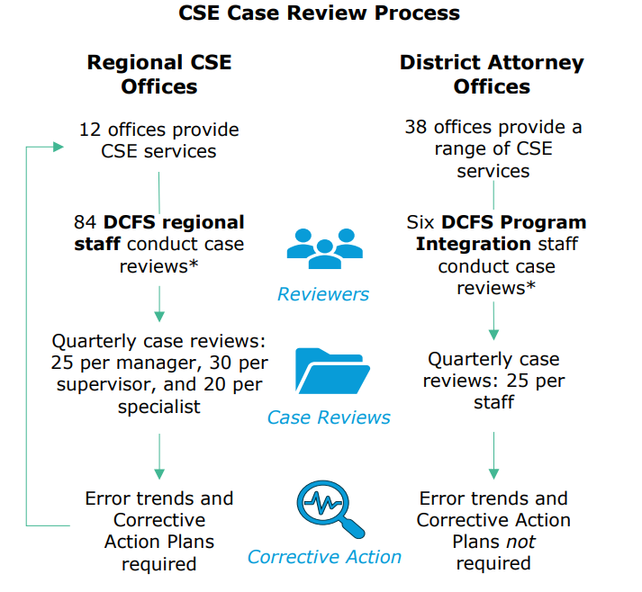
Notes:
a DA caseworker may be responsible for case initiation;
a DCFS caseworker will handle locating the noncustodial parent;
the DA caseworker may assist with establishing the support order; and
the DCFS caseworker will be responsible for enforcement.
Note that QA is not their only job duty

Slide 24
Audit Results – Quality Assurance
Quarterly CSE case reviews are an important quality assurance mechanism.
However, DCFS did not monitor to ensure that staff conducted case reviews in accordance with policy and procedures/expectations during 2022 through 2025 – for both regional offices and Program Integrity.
Notes:
During state fiscal years 2022 through 2025, DCFS did not ensure that all regional staff completed error trends and corrective action plans in accordance with policy.
We found that regional offices did not always develop error trends or corrective action plans and two offices did not develop error trends or corrective action plans at all from the time LASESWeb was launched in April 2021 until January 2025.
In addition, area directors are required by policy to submit a summary of quarterly case reviews to the CSE Director. According to DCFS, these summaries have not been submitted in the past but will be in the future.
DCFS did not ensure that Program Integration staff conducted DA case reviews in accordance with expectations.
As of May 2024, each Program Integration staff is expected to review 25 cases per quarter, or 100 cases per year. During state fiscal year 2025, only one (16.7%) of six Program Integration staff achieved that goal.
In addition, as of September 2025, DCFS had not yet implemented performance-based monitoring for DA Offices.
As of September 2025, no unit is conducting performance-based monitoring of the DA offices relative to the expectations established in the contracts. Case reviews are an important method of assessing DA caseworker performance.

Slide 25
Audit Recommendations
Recommendation 3: DCFS should establish procedures to monitor regional staff compliance with case review policies and procedures, including ensuring that error trends, corrective action plans, and quarterly case review summaries are submitted as required.
Recommendation 4: DCFS should establish procedures to monitor Program Integration staff compliance with case review expectations, including reviewing 25 DA case reviews each quarter, in conjunction with Recommendations 8 through 10.
Recommendation 5: DCFS should implement performance-based monitoring for DA Offices so it can ensure that DA caseworkers comply with program requirements and expectations established in the contracts.

Slide 26
DCFS Response Recommendation 3
Update policy requiring Regional Administrator oversight of case reviews Require submission of corrective action plans (CAPs) and quarterly summaries to CSE Administration Develop standardized compliance report and tracking system to monitor completion Conduct quarterly CAP reviews to identify statewide trends, training needs, and policy revisions Incorporate key findings into monthly Program Integration (PI) presentations
Notes:
Response #3
DCFS is updating policies to require oversight by the Regional Administrators in ensuring case reviews are completed, along with submitting corrective action plans and quarterly case review summaries to CSE State Office. DCFS is developing a compliance report to track completion of case reviews and submissions to monitor regional compliance. CSE Administration is responsible for reviewing the submitted information to identify statewide trends, training needs, and policy revisions, and will incorporate key findings into monthly Program Integration presentations.
Update policy requiring regional staff to submit corrective action plans (CAPs) to CSE Administration.
Develop standardized compliance report to track completion to assist regional staff with monitoring compliance.
Establish tracking system for received CAPs and quarterly summaries.
Review CAPs quarterly to identify training needs and recurring issues.
Incorporate findings into monthly Program Integration presentations.

Slide 27
DCFS Response Recommendation 4
Finalize and implement PI Case Review Process Standardize review template aligned with Scope of Services Require quarterly summaries to CSE Administration Use findings to drive training, policy updates, and system improvements Monitor compliance through monthly oversight
Notes:
Response #4
DCFS has established the Program Integration Case Review Process to ensure that Program Integration staff meet quarterly review goals. Each staff member shall be required to review DA cases, document findings, and submit quarterly summaries to CSE Administration. CSE Administration will then use the information to identify training needs, policy updates, and systemic issues. Staff compliance shall be monitored through monthly check-ins by CSE Administration.
Finalize and implement Program Integration Case Review Process
Discuss/Develop case review documentation template to coincide with Scope of Services
Establish process for quarterly summary submissions to CSE Administration

Slide 28
DCFS Response Recommendation 5
Transitioned DA performance monitoring to CSE Performance Monitoring Unit
Implementing structured, performance-based monitoring framework
Evaluate compliance with contract standards and outcomes
Communicate expectations to DA offices; implementation begins prior to SFY 2027
Notes:
Response #5
DCFS has reassigned responsibility for performance-based monitoring of DA Offices to the CSE Performance Monitoring Unit, which now manages all contract monitoring. Staff in this unit are proficient in CSE program requirements and contract standards. The unit is developing a structured monitoring process to assess DA compliance with performance standards, deliverables, and outcomes. Implementation of this process will begin prior to State Fiscal Year 2027.
Develop structured Performance-Based Monitoring Framework for DA offices
Communicate expectations to DA offices

Slide 29
Audit Results - QA
DCFS did not maintain complete or accurate case review data for reviews conducted by DCFS regional staff during 2022 through 2025.
According to DCFS, 2,033 (25.5%) of 7,975 cases reviewed by regional staff during 2025 had errors. Common errors included caseworkers not taking action on cases, not updating the case files, and not enforcing support orders.
Notes:
DCFS’s LASESWeb system does not accurately reflect whether each case reviewed passed or had errors.
Because we were not able to use LASESWeb data to quantify case review trends over time, we used case review documents and information provided by DCFS to quantify case reviews and errors for state fiscal year 2025. However, we found that this information was also not complete or accurate.
Common Errors -- For example, one reviewer noted that a caseworker had not taken any action on one case for six months, when DCFS has specific timeframe requirements for taking actions on various events occurring during a case. Other review notes indicated that caseworkers were not working tasks and alerts, which are system-generated reminders caseworkers receive via email when action is needed.

Slide 30
Audit Recommendations
Recommendation 6: DCFS should identify the reasons why case review data in LASESWeb is inaccurate and incomplete and address those issues to ensure that the data in LASESWeb is accurate, complete, and available for analysis.
Recommendation 7: DCFS should develop policies and procedures to monitor the case review process to ensure that management can identify and address common error trends.

Slide 31
DCFS Response Recommendation 6
Identify and implement LASESWeb system enhancements Improve data accuracy, completeness, and accessibility Provide targeted training to support effective system use
Notes:
Response #6
DCFS will identify technological improvements for LASESWeb and provide additional training to ensure that the system is providing accurate, complete and assessable data.
Identify and implement system/technical improvements
Response 7: DCFS is refining policies to strengthen oversight of the case review process and ensure consistent identification and reporting of error trends.

Slide 32
DCFS Response Recommendation 7
Refine policies to strengthen case review oversight Ensure consistent identification and reporting of error trends
Notes:
Response #7
DCFS is refining policies to strengthen oversight of the case review process and ensure consistent identification and reporting of error trends.

Slide 33
Audit Results - QA
According to DCFS, 113 (33.5%) of 337 cases reviewed by DCFS Program Integration staff for DA caseworkers during 2025 had errors. However, DCFS had not established formal policies governing Program Integration’s case reviews of DA caseworkers.
Based on current expectations, Program Integration staff may review fewer than four cases per DA offices each quarter, which is fewer than the number reviewed for regional offices (75).
Notes:
DCFS does not require Program Integration staff to report error trends or develop corrective action plans for DA offices. In contrast, DCFS policy requires that CSE office managers use the results of the regional case reviews to identify error trends specific to their offices. The CSE office managers report the error trends to their area director and then work with the area director to develop corrective action plans to address the trends.

Slide 34
Audit Recommendations
Recommendation 8: DCFS should evaluate the case review process and develop formal policies for the number of cases each Program Integration staff should review each quarter, and the number of cases from each DA office.
Recommendation 9: DCFS should evaluate the case review process and determine whether Program Integration staff should develop and submit error trends and corrective action plans -- and formalize this decision in policy.
Recommendation 10: DCFS should develop a process to monitor Program Integration staff to ensure they are conducting case
reviews as required by the newly-developed policies.

Slide 35
DCFS Response Recommendations 8 and 9
Recommendation 8: Define required PI case review volume Implement through PI Case Review Process (Rec. 4) Recommendation 9: Develop and submit error trend reports and CAPs Formalize PI error trend and CAP responsibilities in policy Implement through PI Case Review Process (Rec. 4)
Notes:
Responses #8 & #9:
# 8: In conjunction with Recommendation Response 4, DCFS will define the number of cases to be reviewed by Program Integration.
# 9: In conjunction with Recommendation Response 4, DCFS will develop and submit error trends and corrective action plans.
Formalize Program Integration error trend and CAP responsibilities in policy.

Slide 36
DCFS Response Recommendations 10
Develop policy to monitor Program Integration staff compliance Align oversight with PI Case Review requirements (Rec. 4 & 8)
Notes:
Response #10
In conjunction with Recommendation Responses 4 and 8, DCFS will create policies to monitor Program Integration staff.
Develop policy to monitor Program Integration staff compliance with case review requirements.

Slide 37
Audit Results - QA
DCFS has not established procedures to assess the effectiveness of the case review process, including how results are analyzed, reported, and used.
As a result, DCFS is unable to identify systemic weaknesses and inform corrective actions such as training and policy changes to improve program performance statewide.
Notes:
While the case review process allows CSE office managers and Program Integration staff to identify and correct errors, DCFS has not established procedures to assess the overall effectiveness of the case review process. As a result, DCFS lacks assurance that case reviews are a reliable tool to monitor compliance, or to identify and resolve errors and error trends, and may be missing opportunities to improve the case review process.
To improve effectiveness of the overall QA process, DCFS should evaluate how case reviews are conducted and consider alternative methods for identifying errors and trends. For instance, a risk-based approach that combines targeted error reports with existing random case reviews may better utilize staff time.
DCFS does not systematically integrate the results of case reviews into efforts to improve program performance of both CSE and DA caseworkers. As a result, the department may not identify systemic weaknesses or implement corrective actions, and training needs and policy gaps may go unaddressed. According to DCFS, area directors informally communicate issues regional managers identify in their offices; however, DCFS does not routinely review or analyze the results of case reviews statewide. Developing a system to better use those results could help DCFS improve its child support collection rate.

Slide 38
Audit Recommendations
Recommendation 11: DCFS should establish procedures to assess the effectiveness of the case review process and make improvements as appropriate.
Recommendation 12: When DCFS begins procuring a new child support data system, it should ensure it includes automated quality assurance features in the new system, such as field validation (e.g., rejecting invalid dates), cross-field validation (e.g., comparing timelines to confirm compliance), automated trend analysis, and dashboards to improve oversight.

Slide 39
Audit Recommendations
Recommendation 13: DCFS should establish procedures to review and use the results of case reviews to identify systemic weaknesses and inform corrective actions to improve program performance.

Slide 40
DCFS Response Recommendations 11
Partner with DCFS Bureau of Audit & Compliance Services (independent of CSE) Evaluate effectiveness of case review procedures Analyze and report findings to identify systemic issues Use results to guide training and statewide policy improvements
Notes:
Response #11
CSE Administration will work with the DCFS Bureau of Audit and Compliance Services, which operates independently of CSE, to evaluate the effectiveness of case review procedures. This partnership will ensure that results are properly analyzed, reported, and used to identify systemic issues, guide training, and inform policy improvements statewide.

Slide 41
DCFS Response Recommendations 12
Initiate procurement planning for new child support data system Incorporate automated quality assurance features Include validation controls, trend analysis, and dashboard reporting Enhance data accuracy, monitoring, and program oversight
Notes:
Response #12
DCFS is currently in the planning phase for procurement of a new child support data system to include automated quality assurance features in the system requirements. These features will include field and cross-field validation, automated trend analysis, and dashboard capabilities to enhance data accuracy, monitoring and program oversight.

Slide 42
DCFS Response Recommendations 13
Establish procedures to systematically analyze case review results Identify recurring issues and systemic weaknesses Use findings to guide corrective actions, targeted training, and policy updates Promote continuous improvement statewide
Notes:
Response #13
DCFS is establishing procedures to ensure results from case reviews are systematically analyzed and used to identify recurring issues and systemic weaknesses. The findings will inform targeted corrective actions, training, and policy updates to strengthen program performance and promote continuous improvement statewide.

Slide 43
Implementation & Path Forward
Governance & Oversight
Clear accountability
Structured monitoring
Independent audit collaboration
Performance & Compliance
Standardized reviews & CAP tracking
DA performance monitoring
Systems & Modernization
LASESWeb enhancements
Automated quality controls
New data system procurement
Notes:
As we’ve discussed today, we’ve taken these recommendations seriously and approached them with clear purpose.
We’re strengthening oversight, clarified accountability, and put structured monitoring processes in place to support consistent performance across the program. This work is about building stronger foundations — not just responding to findings.
As we move forward, staff will begin to see updated and newly published policies that reflect these changes. These updates will provide clearer expectations and more consistent processes across regions.
Our focus now is on implementation — ensuring these improvements are practical, sustainable, and support the important work happening every day in the field.

Slide 44
Questions?
Kristen Jacobs
Performance Audit Manager, LLA
kjacobs@lla.la.gov
Patricia Cason
Child Support Enforcement Manager 3, DCFS
Patricia.Cason.DCFS@la.gov
Rennetta Wells
Child Support Enforcement Manager, DCFS
Rennetta.Wells.DCFS@la.gov

