Slide 1
Building Strong Case Foundations
Intake to Assessment

Slide 2
Know Your Goal
Establish
Paternity
Establish
Child Support
Collect
Child Support
Support
Support Louisiana Families

Slide 3
Manage Expectations
Keep Parties Informed
1
Provide Educational Material
2
Process of Establishment and Enforcement
Responsibilities of Parties
Timeframes
Explain Roles
3
DCFS
DA
Court
Sheriff’s Office
Parties
Maintain contact
Phone
Email

Slide 4
Create a Complete Record
LASES Updates
Documentation
Locate

Slide 5

Documentation
Application
Birth Certificates
Affidavit of Paternity (if needed)
Data Reliability Sheets
Social Security Cards
Prior Child Support Orders
Medicaid/Health Insurance Cards
Other Legal Documentation
(Divorce Judgments and Marriage Licenses)
Pay History
LWC/DOL and Work Number

Slide 6
FILENET
Indexing to FILENET real-time
Official Record
Electronic
Any office can review
Easier integration with GovLink

Slide 7
LASES Address Types & Codes
Mailing
Residential
Service of Process
Verified Not Valid
Verified Valid
Not Verified

Slide 8
Updating LASES
01
ARDA
APD1
LICC
EMDA
CONA
MOFD
LICI
Updating Screens

Slide 9
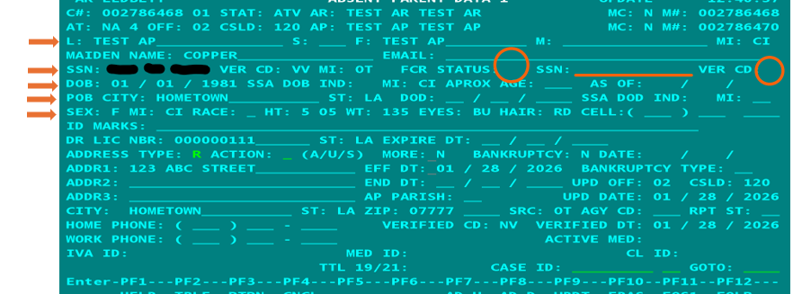
Absent Parent Data 1 (APD1)
Notes:
NOTES:
Enter as much data about the NCP as you can. NCP F and L name. Middle name or initial, if known. Suffix (ex Jr, Sr, III, etc). Maiden name, if applicable.
SSN- may be entered with VV code, if validated or NV code. Entering the data, will submit a match request to the FCR. The FCR match is based on name, SSN, and DOB. FCR status can be A for member accepted, D for member deleted, R for member rejected, or S for member Sent to FCR. If anything other than A or S, need to find out why and take action to correct the issue.
VER CD can be any of the following; for purposes of this presentation,
Blank- SSN was not verified or no SSN was submitted.
C-The SSN submitted was corrected.
E-The SSN/Name combination could not be verified or corrected.
P- The SSN may or may not have been submitted but FCR id’d a SSN
R- The SSN was id’d using the requires manual review process
S- The IRS-U-SSN submitted allowed ID of SSN
V- The SSN/Name submitted was verified by SSA
FCR Query-The Federal Case Registry (FCR) Query is used to search the FCR by a participant’s SSN within your state’s caseload or by your state’s case ID. The SSN must be for a participant on an open case within your state and registered on the FCR. The Federal Case Registry allows you to search for participants and cases you have in common with other states and territories. This application may help with case synchronization, paternity establishment, and establishment/modification of orders. The FCR also interfaces to find matches with external locate partners. Reference FCR handout for more information.
Errors stop transactions from being processed.
Warnings are informative and do not stop transactions from being processed.
It’s possible to receive a combo of errors and warnings. FCR Interface Guidance Document for descriptions of codes.
Informational (warning)
TW102- SSN/Name Combination unverified.
Programming (error)
TE032 Record ID FP with Action Type code A must be present
Synchronization (errors)
PE 002- Case not found on the FCR
PE 004- Person not found on the FCR
07- we don’thave ssn but other state does
08- diff ssn avail from diff state
SS validity code- important. FCR Query app- if you don’t see validity code in system, go to FCR and see what validity code is. Will tell you if VV or not.
New Hire (NH)
o NDNH to FCR proactive match – less than 30 days old
o FCR to NDNH proactive match – up to 6 months old
o Locate request – up to 1 year old
Quarterly Wage (QW)
o NDNH to FCR proactive match – federal agency information less than 30 days old from end of reporting quarter. Other records up to 4 months old from end of the reported quarter.
o FCR to NDNH Proactive Match – up to 12 months old
o Locate request – up to 12 months old
Unemployment Insurance (UI)
o NDNH to FCR Proactive – most recent quarter of data available, up to 4 months old
o FCR to NDNH Proactive – up to 4 months old
o Locate request – up to 12 months old
Social Security Numbers (SSNs) are critical in maximizing the usage of the FPLS. The FCR uses SSNs as key identifiers. The system requires an SSN to store a person on the FCR and to perform Locate Requests. A State must submit either an SSN, or information that is sufficient to identify an SSN, when sending a transaction to add a person to the FCR, or when requesting a Locate. A verified SSN is required in order to perform a Locate Request. The FCR uses only verified SSNs in the Matching or Locate processes. Verified SSNs greatly increase the reliability of data on the FCR. They also ensure that the State receives correct FCR and NDNH matching information to assist them in their child support enforcement efforts.

Slide 10
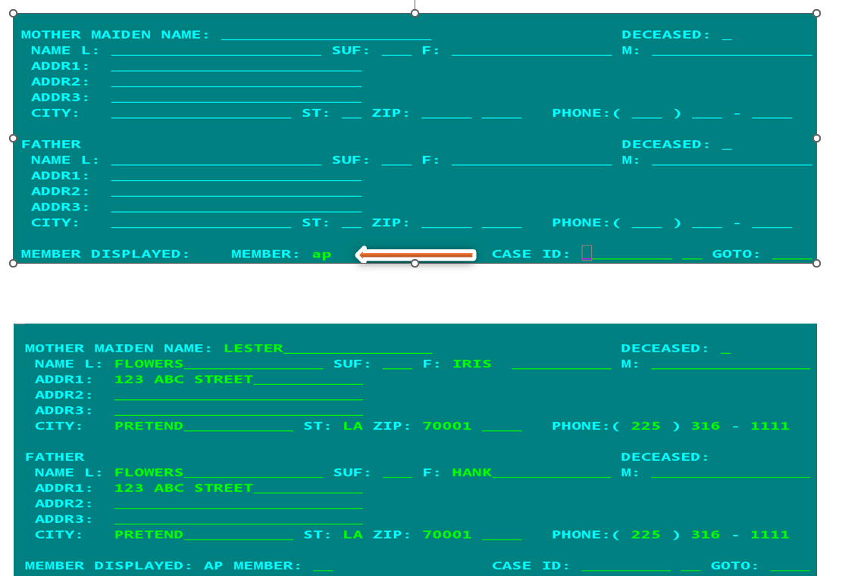
Mother Father Data (MOFD)

Slide 11
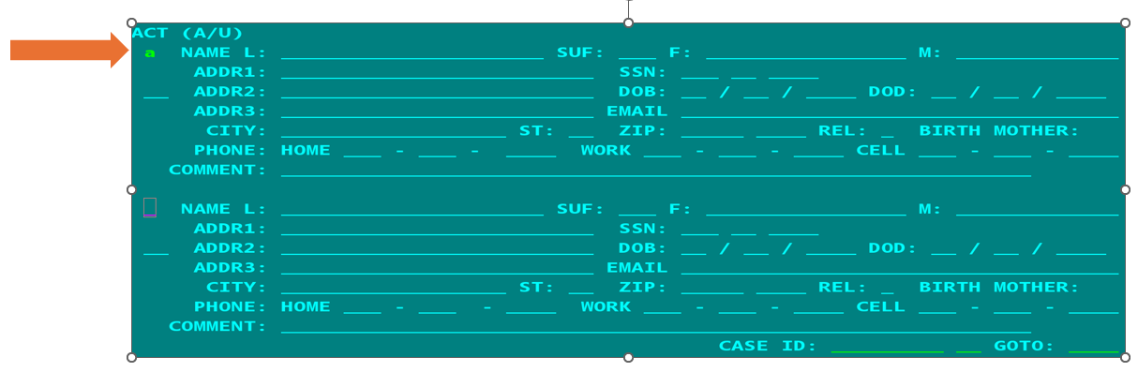
Collateral Names (CONA)

Slide 12
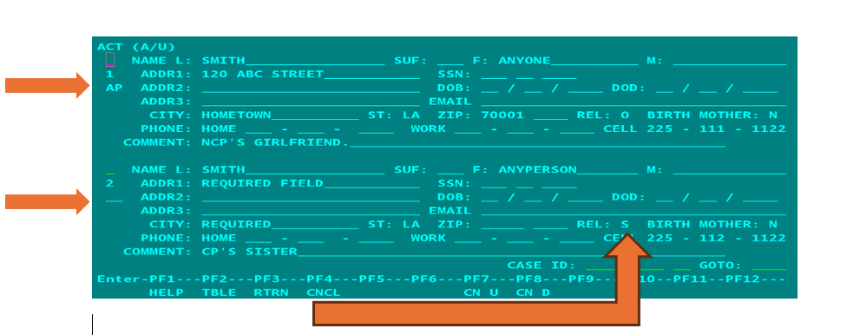
Collateral Names (CONA)
Notes:
RELATIONSHIP OPTIONS:
AUNT BIRTH MOTHER
COUSIN FATHER
GRANDPARENT BIRTH FATHER
LAWYER OR ATTORNEY MOTHER
NIECE OR NEPHEW OTHER
FRIEND SIBLING
UNCLE SPOUSE

Slide 13
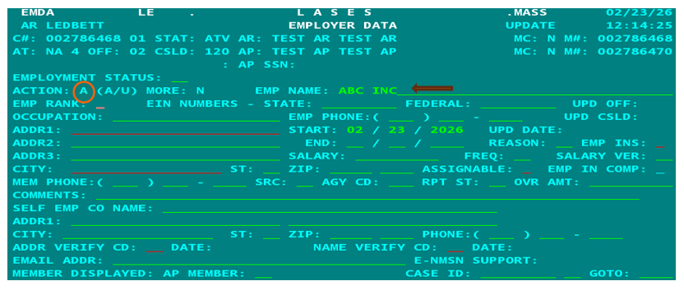
Employer Data (EMDA)
Notes:
Type the employer name and press enter. PF 2 on employer name. This will bring up a list of similar or exact matches. If you know the employer’s Federal Identification Number or FEIN, you can enter the FEIN and F2 for the list of employers.

Slide 14
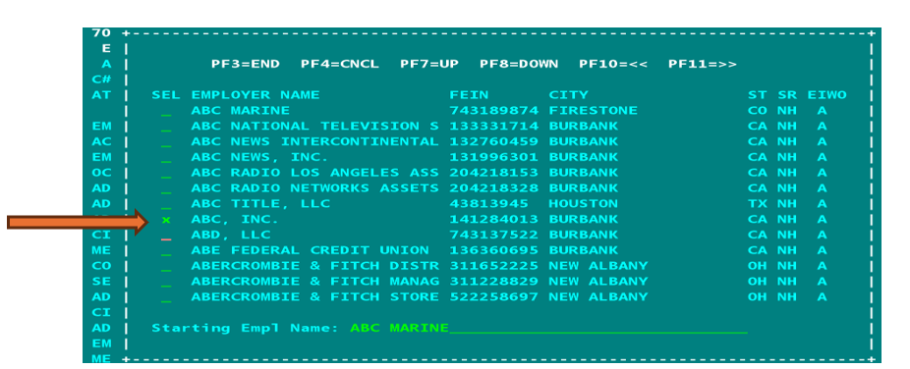
Employer Data (EMDA)

Slide 15
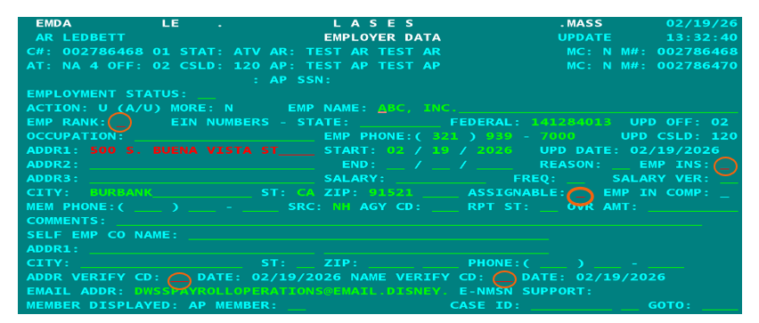
Employer Data (EMDA)

Slide 16
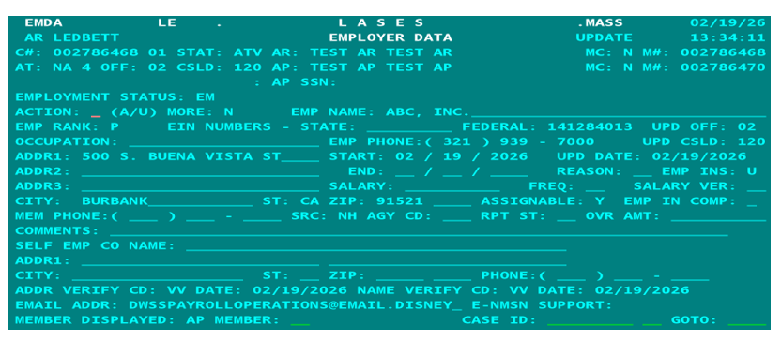
Employer Data (EMDA)

Slide 17
CALOS (Case Logs)
Clear
Detailed
Relevant to Case Function
Signed Off
(first initial/last name)
Types
O-Obligation Establishment
P-Paternity Establishment
F-UIFSA
S-Service

Slide 18
LOCATE
Accurint
Clear
FPLS
FileNet
Work Number
DOL/LWC
Vinelink//Bureau of Federal Prisons
Facebook
Google
INSE
Other Cases
Contact w/parties
204s
Other Court Records
Secretary of State
LITE
LA MEDS
LMFA (Banking Information)
Other Ideas?
Cajun

