Slide 1
The Work in Progress:
A Journey of Becoming
Jay Bland
Chief Growth Officer | GreenCourt Legal Technologies

Slide 2

THE WAKE UP CALL
Some moments don’t just
wake you up.
They change everything.

Slide 3

I was a natural born leader.
And that alone wasn’t enough.
JAY BLAND

Slide 4
START WITH
WHY.
Why are each of you in this room today? Why do you work for this agency?
Why am I here?
I believe most issues in the world — big and small — can be traced back to lack of leadership. I am here because I watched people who depended on me fall victim to my inexperience.

Slide 5
SETTING THE STAGE
Today it’s all about leadership. Before I dive into my journey, let me set the stage.
Beware of anyone who says they have leadership all figured out. No one is perfect. The goal is to make the decision to become a work in progress. Leadership is a journey of becoming — not arrival.
Every person in this room is a leader. Titles don’t matter. You are either leading passively or leading intentionally.
Leadership is INFLUENCE. Everyone influences people — positively or negatively. Fight the urge to think “this is for people higher up.” Managers: expect moments that make you stop and think. Those aspiring to move up: this is your roadmap. Those who do the work every day — these lessons will help you influence those around you in a more positive way.
Success today = everyone deciding to take inventory of themselves. How are you showing up? Are you positively influencing those around you? What could improve?
Imagine an agency where everyone shows up as an intentional leader.

Slide 6
LEADERSHIP IS
INFLUENCE.
And everyone influences people.
You either do it positively or negatively.

Slide 7

THE BEGINNING
The journey of becoming
starts with a single step.

Slide 8
I became addicted
to helping people.

Slide 9



+
=
INTENTION
ACTION
TRANSFORMATION
The decision
to grow
Daily, intentional
investment
Who you
become

Slide 10



THREE LESSONS
FROM THE JOURNEY
POSTURE OVER POSITION
CONGRUENCE
LEADING WITH A FULL CUP

Slide 11



LESSON 1
Posture Over Position
Set the Example
Own Your Wake
Little things matter. Focus, timeliness, meeting hygiene. Do the small things right first.
You're a boat moving through water. Everything behind you is affected. Be aware of the ripples.
Curiosity, Not Judgment
Lead with Vulnerability
When someone falls short, ask questions before you correct behavior.
Let people see you're human. That you're a work in progress too.

Slide 12
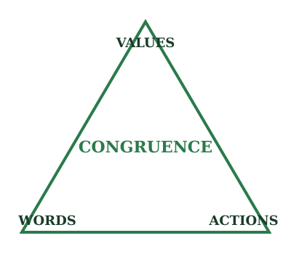
LESSON 2
Congruence
Agreement or harmony.
Compatibility between what you say you want and what you actually do.
Define what you want to be.
Then make sure your actions are congruent with that vision.

Slide 13
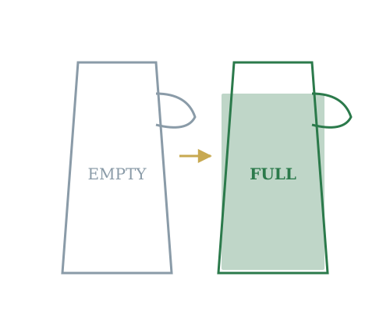
LESSON 3
Leading with a Full Cup
Mental health. Self-care. Wellness.
If your cup is empty, you have nothing to give.
And leadership is giving.
Taking care of yourself isn't selfish. It's the most others-focused thing you can do.

Slide 14
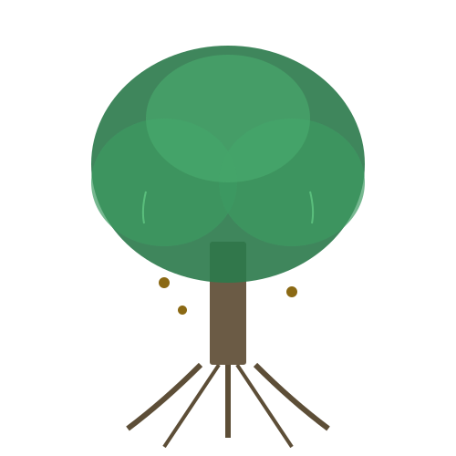
THE OAK TREE
Leaders as Ecosystems

Slide 15
ROOTS
Deep routines, disciplines, habits, self-care. Take care of yourself first.
ECOSYSTEM
A single tree creates flourishing for everyone in its shade.
ACORNS
Leaders develop leaders who develop leaders. The butterfly effect.
SEASONS
Every year, drop your leaves and regrow. Leadership is ongoing work.
LEGACY
Some of those trees aren't around anymore. But I still remember them.

Slide 16
THE CHOICE
There are a ton of right ways to be a good leader.
Not all good leaders look and act the same.
But the bad ones all share the same characteristics.
They never made the choice to be intentional.

Slide 17
The Journey is the Goal
Becoming is the work.

Slide 18
THANK YOU
Jay Bland
Chief Growth Officer | GreenCourt Legal Technologies
jbland@greencourt.com | greencourt.com

