Slide 1
ENFORCEMENT
Finding the Right Fit

Slide 2
Overview of Enforcement
Enforcement is one of CSE’s most important functions for bringing cases into compliance. CSE has a full toolbox of administrative and judicial tools available. No matter which is used, the goal is not just action, but the right action that results in payment.

Slide 3
Overview of Enforcement
When assessing a case for enforcement, we should:
Take time to understand the reason for noncompliance.
Match the enforcement tool to the situation
Focus on actions that encourage cooperation and payment.
Avoid measures that do not move the case forward.
Remember the goal of enforcement is consistent support payments, not penalty.

Slide 4
Contact with NCP for Early Engagement
Instrumental in enforcing cases.
Establishes a rapport with the NCP
Verify contact (i.e. phone number, email, and address)
Verify employer information
Obtain other and preferred means of contact

Slide 5
What’s in our Enforcement Toolbox
Income Assignment Order (IAO, IWO)
License Suspension (Administrative)
Passport Denial
Consumer Credit Reporting
Asset Seizure
Liens
Automated Financial Intercepts
Contempt

Slide 6
What's in the Toolbox - Income Assignment Order
When a child support case is established, take these steps to secure payment:
Obtain the Income Assignment Order from the court.
Generate a CSE 415
Electronically, if the company participates in E-IWO
Via LASES or manually when E-IWO is not available
Best Practices after generating the CSE 415
Confirm the employer received the order and is complying.
Monitor payments to ensure they are timely and accurate.
Update the case promptly if the NCP’s employment or income source changes.
Notes:
Income assignment is one of CSE’s most effective enforcement tools because it collects support directly from the source payor of income before the NCP receives it. This method promotes consistent, timely payments and reduces the need for more aggressive enforcement actions.
Section 466(b)(1) of the Social Security Act requires withholding "in the case of each noncustodial parent against whom a support order is or has been issued or modified in the State." Therefore, the first condition for withholding is an underlying support order issued in accordance with Federal requirements and State law.

Slide 7
What’s in the Toolbox - Administrative License Suspension
Administrative License suspension is an effective tool for the enforcement of a child support order. (LA R.S. 9:315.40)
Be mindful to ensure that you have screened each case that you consider using license suspension
Not limited to only Louisiana Driver's License.
Notes:
Per LA R.S. 9:315.40, CSE may administratively suspend license(s) of child support obligors who are not in compliance with an order of support and are delinquent at least 90 days in the payment of support, or in making periodic payments on a support arrearage pursuant to a court order or written agreement with CSE.
Policy K-410 provides a directory of Licensing Agencies

Slide 8
When to use the Toolbox - Administrative License Suspension
When considering administrative license suspension, the case must meet at least one of the conditions below:
Income assignment is not feasible,
Income assignment is in place, but obligation amount is not met.
The NCP is not making any payments.
Notes:
In addition to the 90 day delinquency requirement and the existence of a license to pursue,

Slide 9
When to use the Toolbox - Administrative License Suspension
When considering administrative license suspension, the case must meet at least one of the conditions below:
The NCP is making only periodic payments, and the payments are less than the current support amount.
The NCP is making regular payments, but the payments are less than the current support amount and the caseworker has reason to believe that the NCP can afford to pay more.
Notes:
In addition to the 90 day delinquency requirement and the existence of a license to pursue,

Slide 10
When to use the Toolbox - Administrative License Suspension
Prior to initiating license suspension process, analysts should evaluate the case thoroughly.
Review employment history, incarceration status, inability to pay and disability status.
Attempt contact with the NCP (phone, mail, email, collateral, etc.)
If contact is made, determine the NCP’s ability to pay.
If no contact can be made, schedule appointment with NCP.
If appointment is missed, send 440A.

Slide 11
Administrative License Suspension The Process
Once ability to pay is determined or 14 days from the 440A has passed, send a 440 certified mail, return receipt requested.
When postal service shows accepted, refused or unclaimed, wait 20 days from the date of USPS service to suspend the license.
Input information into LISU/ALSD entry and have supervisor/manager review for final determination.

Slide 12
Administrative License Suspension The Process
If the NCP contacts the Department after receiving the CSE 440, the analyst should work with the NCP to reach a reasonable agreement to pay arrears and current support.
Complete a CSE 442 with the NCP. The license shall not be suspended as long as the NCP is in substantial compliance with the agreement.

Slide 13
Administrative License Suspension The Process
Subsequent compliance:
Be up to date with current child support payments
Have paid all past due support or be making periodic payments in accordance with either a court order or a written agreement made with the CSE or DA staff responsible for administrative enforcement.
Have provided health insurance, if required to do so.
Complete a CSE 448 SUB
To fulfill requirement of subsequent compliance, the agreement must be fulfilled for six months.
Once obligor is in subsequent compliance and request reissuance of license, issue form CSE 443.

Slide 14
Administrative License Suspension
Partial compliance:
Ability to comply with the order of support
Entering into a written agreement with the Department
Complete a CSE 448 PAR
Written agreement must include amount specified for payment towards arrears in addition to court ordered obligation and administrative fee.
CSE 449 PAR releases the license
If NCP fails to comply with agreement resuspend license via LISU.

Slide 15
Administrative License Suspension What to do – Administrative Hearing requested
The NCP has 20 days from the receipt of the CSE 440 to request an administrative hearing.
Even if a request for administrative hearing is not received timely but prior to the actions being taken to suspend a license an administrative hearing should be requested.
Administrative Hearings related to license suspension are conducted by the Division of Administrative Law (DAL).
Notes:
For further guidance on Administrative Hearings, refer to policy K-340.

Slide 16
What's in the Toolbox: Passport Denial
Federal law allows passport action when an NCP owes
more than $2,500 in past-due child support.
Louisiana uses the same $2,500 arrears threshold.
An NCP is removed when:
Arrears drop under $2500
The case is deleted or excluded, or
The district office may request removal when the case
meets one of the criteria under Policy K-570 after an NCP makes a request for removal.
Notes:
When CSE submits a case for Federal Tax Offset, OCSS automatically sends eligible
cases to the U.S. State Department for passport denial.
The State Department flags the NCP, and the passport is denied at the time of application.
The State Department notifies the NCP and refers them back to the child support office
for questions.

Slide 17
What's in the Toolbox: Credit Reporting
In IV-D cases, a balance of $1,000 or more must be owed.
Advance notice of delinquency, CSE 002, is generated to the NCP by LASES two months prior to the initial submittal.
Submittal is done to all three major credit bureaus
Notes:
Section 466(a)(7) of the Social Security Act requires all states IV-D agencies to have procedures for reporting NCP’s owing past due support to consumer reporting agencies.
LASES payment information on cases with past due support are submitted to the Consumer Reporting Agencies monthly. At initial submittal, the arrears must equal twice the obligation amount.

Slide 18
Credit Reporting
Once a child support case has been submitted to the Consumer Reporting Agencies, updates are submitted monthly.
The NCP receives the notice of submittal annually.
Updates continue unless the suppression field on the CORD Screen is changed from "N" to "Y", the only debt on the case is closed, or the case status is changed to closed.
If the case status is changed to closed, LASES will send a deletion request.

Slide 19
Credit Reporting
The “U-A-S-P” Rule – When to Suppress Reporting
Suppress consumer reporting ONLY when you have:
U – UIFSA Initiating case A – AEI case S – SSN incorrect for the NCP P – PA status = 7
➕ And when arrears are under $1,000

Slide 20
Interstate Enforcement UIFSA (Uniform Interstate Family Support Act)
UIFSA Includes a provision for direct income withholding.
Should be used if all other administrative enforcement methods are attempted and the non-custodial parent resides in another state.
Request registration and enforcement of a Louisiana court order. (Transmittal #1)
Can also request several limited services actions, such as:
Locate, Liens, AEI

Slide 21
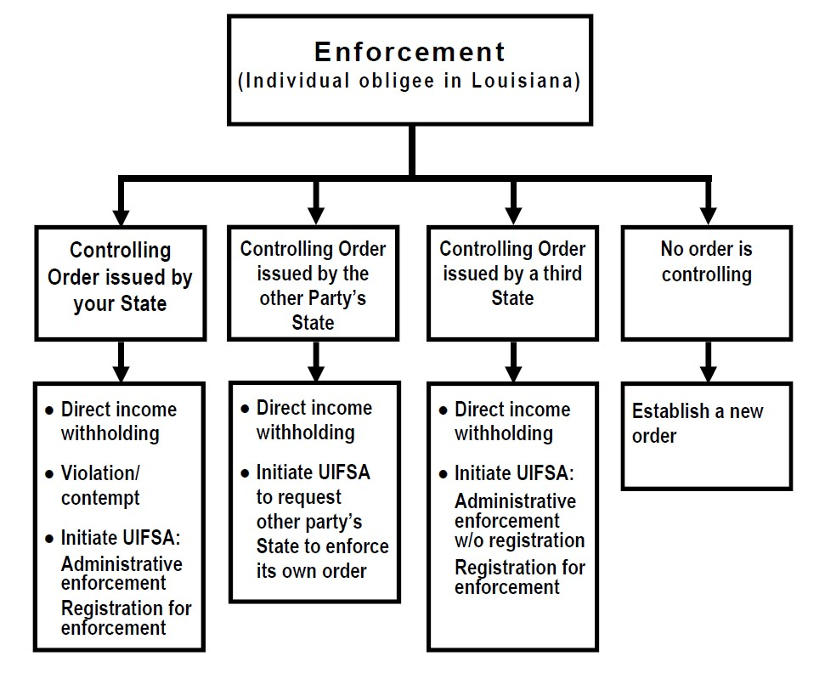
UIFSA (Uniform Interstate Family Support Act)

Slide 22
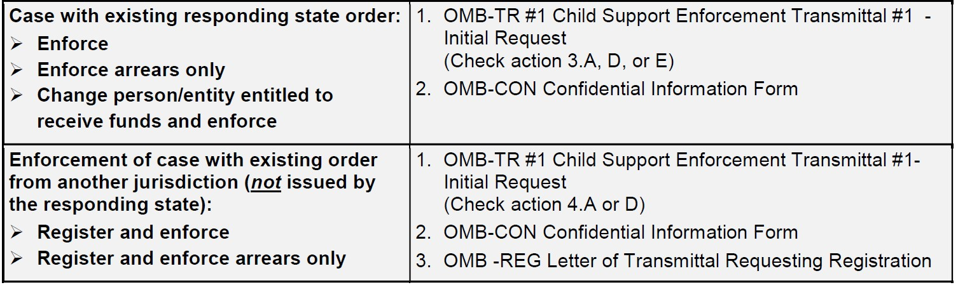
UIFSA (Uniform Interstate Family Support Act)

Slide 23
UIFSA (Uniform Interstate Family Support Act)
Tips for registering orders for enforcement:
Make sure that the NCP address is verified, recommended to have a recent 240 confirming address.
Include a 361 Affidavit of Arrearage with your request.
Include a certified copy of the support order, some states have accepted the CSE 60 with a copy of the support order.
If the responding state asks for additional information or documentation, ensure prompt response so they do not close their case.

Slide 24
What's in the Toolbox Asset Enforcement - Freeze and Seize
LA R.S. 46:236.15 (D)(1) provides authority for CSE to intercept, encumber, freeze, and/or seize the following:
Periodic or lump sum payments from state of local agency, including bot not limited to, unemployment compensation benefits, worker's compensation, and other benefits;
Judgments, settlements;
Lottery winnings, cash gaming winnings, progressive slot machine annuities, beginning with the second annuity payment;
Assets held in financial institutions; and
Public and private retirement funds.

Slide 25
Asset Enforcement - Freeze and Seize The Process
These actions may only be pursued if:
There is an available balance of more than:
$500 in the savings, money market, IRA/KEOGH, or trust/escrow accounts; or
$2000 in the checking account.
The noncustodial parent does not receive SSI, SSI/SSR or a combination of SSI and SSDI benefits.
Louisiana is not listed as the initiating state on CACI.

Slide 26
Asset Enforcement - Freeze and Seize Considerations
For CSE purposes, consider seizing assets only when one of the following conditions are present:
Arrears are more than six months delinquent or;
There has been no payment received on the arrearages in the last six months or;

Slide 27
Asset Enforcement- Freeze and Seize Considerations
The NCP is making regular payments on the arrearage, but the arrearage is so large that it will not be paid off in a reasonable period of time or;
The arrearage is fairly small, but the NCP is not making any payments at all, or is making sporadic or partial payments or;
The NCP is not complying with the court order or a written agreement entered with the child support office.

Slide 28
What's in the Toolbox - Liens
CSE certifies the past due amount of arrears
Once filed, creates a legal mortgage and privilege.
Affidavit operates as a lien on property owned by NCP
Applies to the certified arrears and any additional arrears
Liens can be powerful tools to collect arrears, especially if you know that there is property owned.
Notes:
LA R.S. 13:4291 (B) provides authority for the Director of CSE , or his designee, to certify the actual amount of past due support in an affidavit entitled “Child Support Mortgage and Privilege by Affidavit of DCFS.” Such affidavit will have the effect of a judgment and, when filed and recorded in the manner provided by law, creates a legal mortgage and privilege.
Upon filing with the Clerk of Court, the affidavit operates as a lien on movable and immovable property owned by the NCP. The filing of the affidavit applies to the certified arrears, and any additional arrears accruing after the lien is filed.

Slide 29
Using the Toolbox - Liens
CSE must serve 30 day advance notice to the NCP on a CSE 150 prior to an affidavit being filed and recorded.
NCP has 15 days from date of service to file an appeal.
If an appeal is filed, a court hearing must be scheduled for the court to hear the appeal.
If the NCP does not appeal, CSE will proceed with filing and recording the affidavit.

Slide 30
Using the Toolbox - Liens
Complete the CSE 151. This affidavit may be recorded in the mortgage records of any parish where the NCP owns or is thought to own property.
If you have already obtained a money judgment, that judgment may be filed in a parish where NCP’s owns or is thought to own property.
If the lien or money judgment does not include a social security number and date of birth, use a CSE168 to attach for filing purposes.
Notes:
The CSE Director, or the designee, may release the property subject to the affidavit, if it is determined that the support obligation and arrears are sufficiently secured by a lien or judgment on other property or security, or that the release will not endanger or jeopardize the collection of the support obligation or arrears.
CSE does not routinely cancel mortgages/liens when all arrears are paid. However, if the NCP requests that the mortgage be canceled after all arrears are paid, complete the form CSE 475, and give it to the NCP. The NCP is responsible for filing the cancellation.

Slide 31
What's in the Toolbox - Financial Intercepts
The financial intercept tools run automatically in the background. Analysts do not manually trigger them. The system does the work once the case data is entered.
Analysts must:
Enter debt accurately and timely.
Apply all credits before submission deadlines.
Ensure balances are correct so eligibility can be determined.
Once the data is entered, the system evaluates the case and submits eligible NCPs based on arrears.

Slide 32
What's in the Toolbox - Financial Intercepts
Intercepts capture money owed to the custodial parent and apply it to child support arrears, helping bring cases back into compliance without court action.
If the NCP qualifies, they may be submitted for:
Federal Tax Intercept – Takes past-due support from federal tax refunds.
State Tax Intercept – Applies Louisiana state tax refunds to arrears.
Lottery Intercept – Captures lottery winnings to pay child support.
Insurance Intercept – Applies settlement or insurance payouts to arrears.
Unemployment & Other Benefits Intercept – Redirects benefit payments to support obligations.

Slide 33
What's in the Tool Box Judicial Enforcement - Contempt
The “C-P-N-F Path” to Civil Contempt
Before you refer for contempt, follow the path:
C — Check the case enforcement with CSE 124 (Checklist). P — Prove ability to pay with CSE 125 (documented, signed, any method). N — Notify the NCP with CSE 104E (appointment + ability-to-pay notice). F — File the referral in GovLink using CSE 102.

Slide 34
Judicial Enforcement - Contempt The Process
If the NCP appears, serve CSE 651 (Summons) and attach it to the GovLink CSE 102 with the 124 & 125.
If no appearance or no service: attempt contact, mail 104E + 125, offer one reschedule.
No response, no 125, no reschedule, or no 90-day compliance → proceed with referral.

Slide 35
Judicial Enforcement - Contempt The Process
Arrears executory? Refer for Judgment Debtor Rule, then contempt.
After Ruling, submit via Govlink the CSE 102 referral to request contempt
Arrears Not executory? Refer for contempt and note court must determine ability to pay.

Slide 36
When to Switch Tools
To Escalate - An analyst switches to escalation when the current tool is no longer effective or the risk of noncompliance has increased.
Repeated noncompliance after warnings or lighter enforcement actions.
Failure to respond to outreach, appointments, or payment opportunities.
New information showing the NCP has the ability to pay but refuses to comply.

Slide 37
When to Switch Tools
To Pause - An analyst pauses enforcement when more information or clarity is needed.
Conflicting or incomplete evidence (i.e. wrong NCP or SSI recipient)
Awaiting response for an appeal or appeal decision is pending
To avoid incorrect or unfair enforcement

Slide 38
When to Switch Tools
To Deescalate- An analyst switches to de-escalation when risk of noncompliance decreases or compliance improves.
Initial action achieved the intended outcome
Compliance with the order has been reached
An agreement to pay has been reached

Slide 39
Closing
Analysts have a wide array of tools to enforce cases from automated, administrative, and judicial actions.
Reviewing and assessing cases regularly helps determine which tools are best for your case specific situation.
These tools combined with regular communication with the NCP can lead to positive results towards collection and disbursement of payments for the children of Louisiana.

