Slide 1
Gold Medal Connections: Managing Interstate Child Support with Precision
Charmine Anderson
CSE Policy Unit Consultant
State Office
Gary Franklin
Attorney IV
Bureau of General Counsel

Slide 2
UNIFORM INTERSTATE FAMILY SUPPORT ACT (UIFSA)
The Uniform Interstate Family Support Act (UIFSA) provides universal and uniform rules for the enforcement of family support orders by:
setting basic jurisdictional standards for state courts;
determining the basis for a state to exercise continuing exclusive jurisdiction over a child support proceeding;
establishing rules for determining which state issues the controlling order in the event proceedings are initiated in multiple jurisdictions;
providing rules for modifying or refusing to modify another state’s child support order;
and establishing a mechanism to obtain assistance from other states.

Slide 3
What is the Purpose of UIFSA
The purpose of UIFSA is to regulate a “one order” system for the establishment of, modification of, and maintenance of support orders.
1 + 0 =1
1 - 0= 1
1 × 1 =1
1 ÷ 1= 1

Slide 4
What Version of UIFSA Does Louisiana Have
LOUISIANA ADOPTED 1992 VERSION OF UIFSA IN 1995
LOUISIANA ADOPTED 1996 VERSION OF UIFSA IN 1997
LOUISIANA DID NOT ADOPT 2001 VERSION OF UIFSA
LOUISIANA ADOPTED 2008 VERSION OF UIFSA IN 2015

Slide 5
Key Terms – Types of Child Support Cases
Intrastate case – involves only one state where both parents live
One-state remedies – involves one state taking action against parent in another state
Interstate IV-D case – involves two states: initiating state and responding state
Issuing state (UIFSA) – state that issued support and/or parentage order

Slide 6
Key Terms- Types of Child Support Cases
Responding state (UIFSA)- state where a petition or pleading is filed or to which a petition or pleading is forwarded to for filing
Initiating agency (federal law) – IV-D agency where parent is receiving services (Services may include referral of case to responding agency)
Responding agency (federal law) – IV-D agency providing services in response to referral from initiating agency

Slide 7
Key Terms – Types of Child Support Cases
Tribunal (UIFSA) – court, IV-D agency, or quasi-judicial entity authorized to establish, enforce, or modify support orders or determine parentage
Initiating State-state from which the pleading or petition is filed or the location from which the pleading or petition is sent out to another state

Slide 8
CHILD SUPPORT ENFORCEMENT POLICY
OVERCOMING UIFSA HURDLES

Slide 9
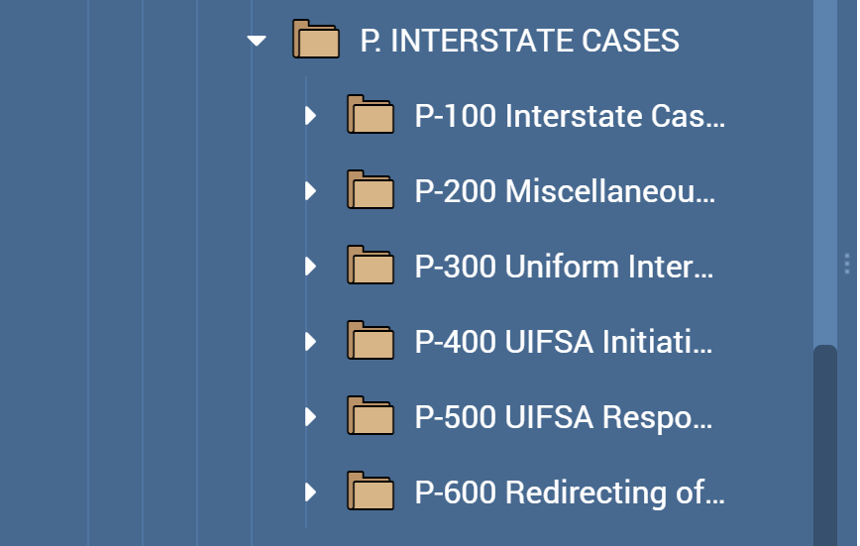
Interstate Policies in PowerDMS
P-100 Interstate Cases
P-200 Miscellaneous Interstate Provisions
P-300 Uniform Interstate Family Support Act (UIFSA)
P-400 UIFSA Initiating Interstate Cases
P-500 UIFSA Responding Interstate Cases
P-600 Redirecting of Support Payments

Slide 10
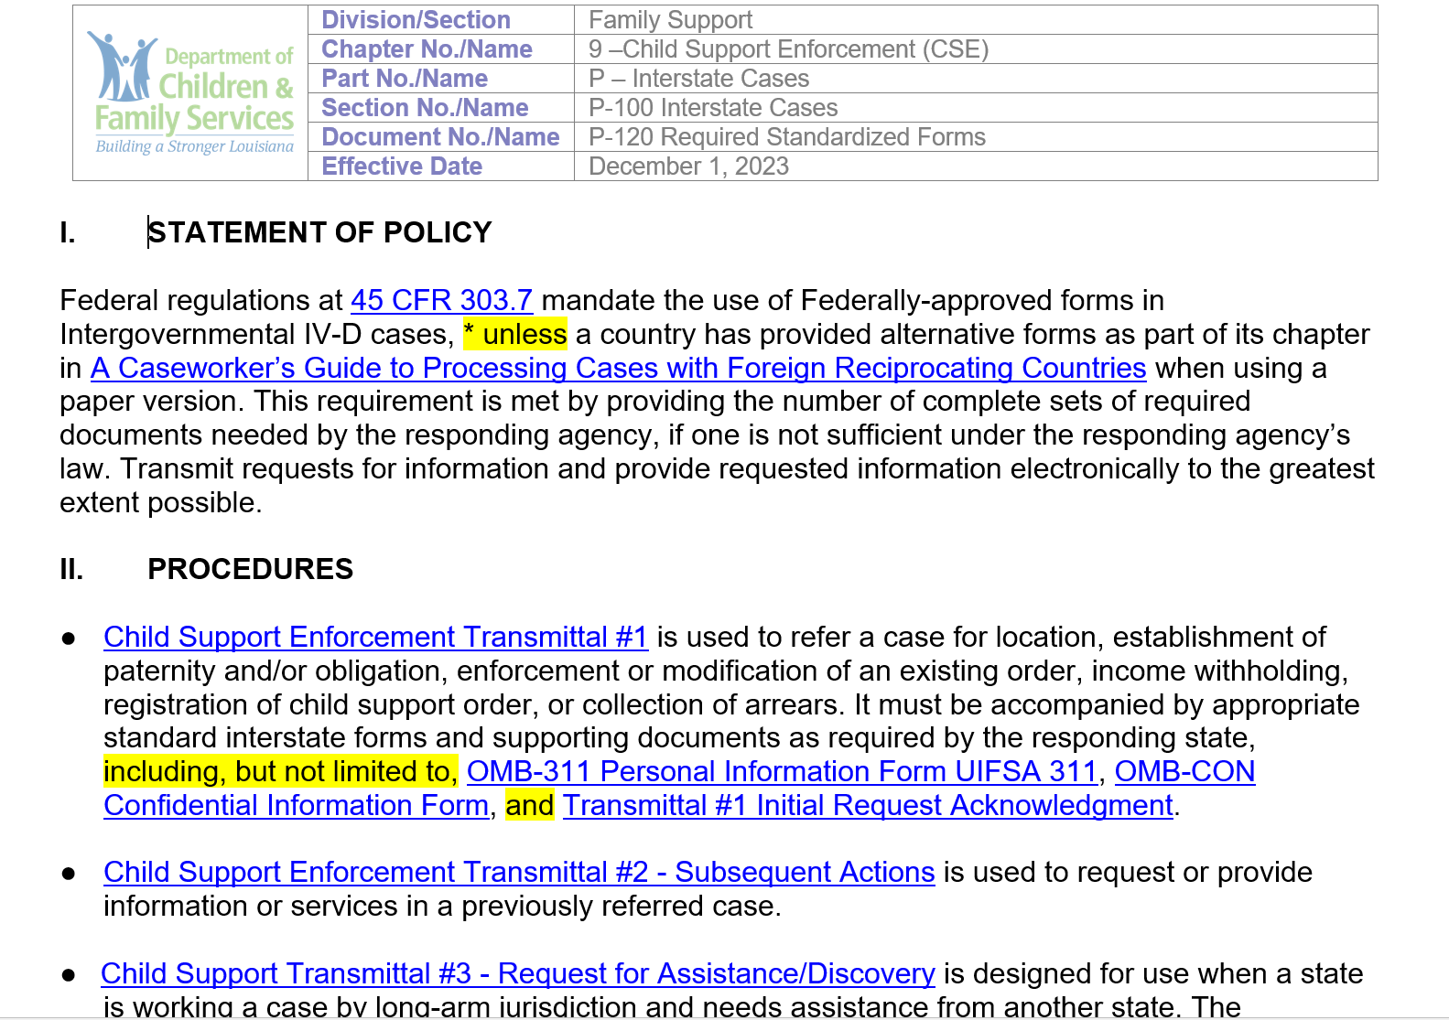
P-120 Required Standardized Forms
Child Support Enforcement Transmittal #1
OMB-311 Personal Information Form UIFSA 311
OMB-Con Confidential Information Form
Transmittal #1 Initial Request Acknowledgment
Child Support Enforcement Transmittal #2
Child Support Transmittal #3-Request for Assistance/Discovery

Slide 11
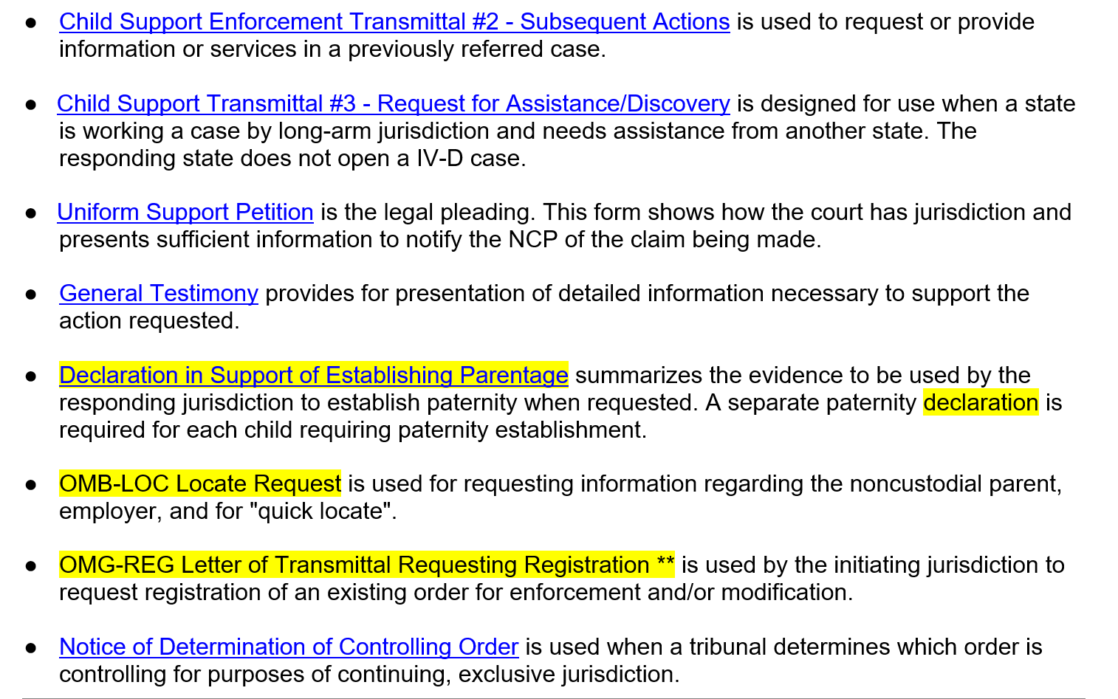
P-120 Required Standardized Forms
Uniform Support Petition
General Testimony
Declaration in Support of Establishing Parentage
OMB-Locate Request
OMB-Reg Letter of Transmittal Requesting Registration
Notice of Determination of Controlling Order

Slide 12
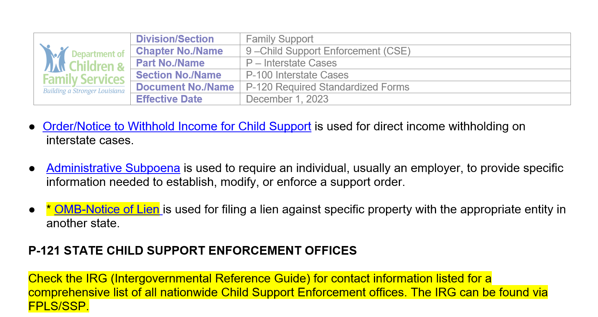
P-120 Required Standardized Forms
Order/Notice to Withhold Income for Child Support
Administrative Subpoena
OMB-Notice of Lien

Slide 13
UIFSA CAUTION
SAFEGUARD CONFIDENTIAL
INFORMATION

Slide 14
Requests to open an Intergovernmental Case
Intergovernmental forms requirements are listed on the UIFSA forms matrix. Additional documents may be required, depending on the case circumstances and responding state requirements. Check the Intergovernmental Reference Guide (IRG), contact the responding state, or do both to determine requirements before sending a case.
Intergovernmental forms: https://www.acf.hhs.gov/css/resource/uifsa-intergovernmental-child-support-enforcement-form

Slide 15
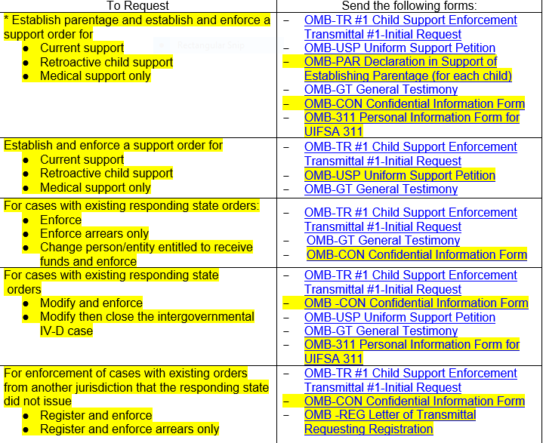
P-130 UIFSA Forms Matrix

Slide 16
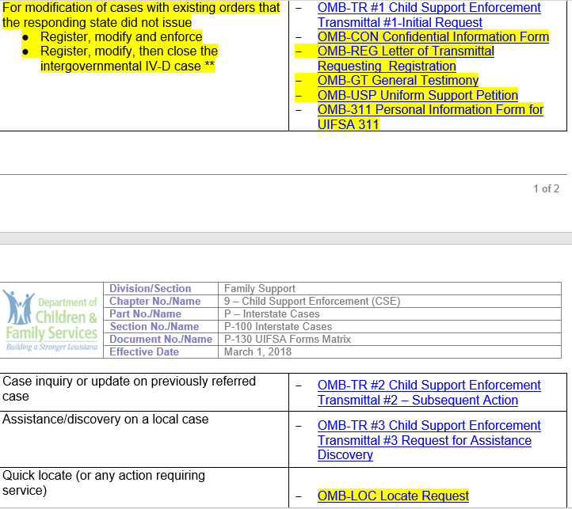
P-130 UIFSA Forms Matrix

Slide 17
CENTRAL REGISTRY
Each state IV-D agency must establish a central registry that will receive UIFSA packets, transmit or forward packets, and respond to inquiries on all incoming intergovernmental IV-D cases to ensure each case receives attention.

Slide 18
Central Registry
45 CFR 303.7
Within 10 working days of receipt of an intergovernmental IV-D case, the central registry must:
(i) Review documentation submitted with the case to determine completeness;
(ii) Forward the case either to the central State Parent Locator Service for location services or to the appropriate agency for processing;
Chapter 9 policy, C-610

Slide 19
Central Registry
45 CFR 303.7
(iii) Acknowledge receipt of the case and request any missing documentation; and
(iv) Inform the initiating agency where the case was sent.
(3) If the documentation received with a case is incomplete and cannot be remedied by the central registry without the assistance of the initiating agency, the central registry must forward the case for any action that can be taken pending necessary action by the initiating agency.
(4) The central registry must respond to inquiries from initiating agencies within 5 working days of receipt of the request for a case status review.
Chapter 9 policy C-610

Slide 20
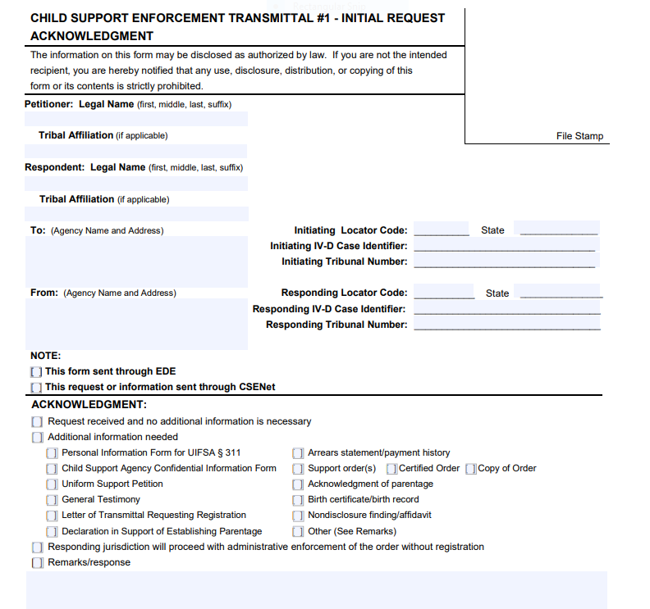
Transmittal #1 Acknowledgment

Slide 21
CENTRAL REGISTRY ASSISTANCE
Initiate a request to central registry after 30 days have passed from the last contact with the responding state. When requesting assistance from Louisiana Central Registry, send the following:
Form SES 366 including a brief summary of case activity and proof of contacts with the other state;
A copy of the Child Support Enforcement Transmittal submitted at time of the initial and follow-up requests; and
Copies of related correspondence and a copy of the court order, if applicable to the issue.
Chapter 9, policy C-620

Slide 22
DEFINING YOUR LIMITS
INITIATING AND RESPONDING INTERSTATE CASES

Slide 23
Initiating Interstate Case
45 CFR 303.7
The initiating State IV-D agency must:
(1) Determine whether or not there is a support order or orders in effect in a case using the Federal and State Case Registries, State records, information provided by the recipient of services, and other relevant information available to the State;
(2) Determine in which State a determination of the controlling order and reconciliation of arrearages may be made where multiple orders exist;
(3) Determine whether the noncustodial parent is in another jurisdiction and whether it is appropriate to use its one-state remedies to establish paternity and establish, modify, and enforce a support order, including medical support and income withholding;
(4) Within 20 calendar days of completing the actions required in paragraphs (1) through (3) and, if appropriate, receipt of any necessary information needed to process the case:
(i) Ask the appropriate intrastate tribunal, or refer the case to the appropriate responding State IV-D agency, for a determination of the controlling order and a reconciliation of arrearages if such a determination is necessary; and

Slide 24
Initiating Interstate Case
45 CFR 303.7
(ii) Refer any intergovernmental IV-D case to the appropriate State Central Registry, Tribal IV-D program, or Central Authority of a country for action, if one-state remedies are not appropriate;
(5) Provide the responding agency sufficient, accurate information to act on the case by submitting with each case any necessary documentation and intergovernmental forms required by the responding agency;
(6) Within 30 calendar days of receipt of the request for information, provide the responding agency with an updated intergovernmental form and any necessary additional documentation, or notify the responding agency when the information will be provided;
(7) Notify the responding agency at least annually, and upon request in an individual case, of interest charges, if any, owed on overdue support under an initiating State order being enforced in the responding jurisdiction;
(8) Submit all past-due support owed in IV-D cases that meet the certification requirements under § 303.72 of this part for Federal tax refund offset,

Slide 25
Initiating Interstate Case
45 CFR 303.7
(9) Send a request for review of a child support order to another State within 20 calendar days of determining that a request for review of the order should be sent to the other State and of receipt of information from the requestor necessary to conduct the review in accordance with section 466(a)(10) of the Act and § 303.8 of this part;
(10) Distribute and disburse any support collections received in accordance with this section and §§ 302.32, 302.38, 302.51, and 302.52 of this chapter, sections 454(5), 454B, 457, and 1912 of the Act, and instructions issued by the Office;
(11) Notify the responding agency within 10 working days of case closure that the initiating State IV-D agency has closed its case pursuant to § 303.11 of this part, and the basis for case closure;

Slide 26
Initiating Interstate Case
45 CFR 303.7
(12) Instruct the responding agency to close its interstate case and to stop any withholding order or notice the responding agency has sent to an employer before the initiating State transmits a withholding order or notice, with respect to the same case, to the same or another employer unless the two States reach an alternative agreement on how to proceed; and
(13) If the initiating agency has closed its case pursuant to § 303.11 and has not notified the responding agency to close its corresponding case, make a diligent effort to locate the obligee, including use of the Federal Parent Locator Service and the State Parent Locator Service, and accept, distribute and disburse any payment received from a responding agency.

Slide 27
Responding Interstate Case
45 CFR 303.7
The responding State IV-D agency must:
Accept and process an intergovernmental request for services, regardless of whether the initiating agency elected not to use remedies that may be available under the law of that jurisdiction;
(2) Within 75 calendar days of receipt of an intergovernmental form and documentation from its central registry:
(i) Provide location services in accordance with § 303.3 of this part if the request is for location services or the form or documentation does not include adequate location information on the noncustodial parent;
(ii) If unable to proceed with the case because of inadequate documentation, notify the initiating agency of the necessary additions or corrections to the form or documentation;
(iii) If the documentation received with a case is incomplete and cannot be remedied without the assistance of the initiating agency, process the case to the extent possible pending necessary action by the initiating agency;

Slide 28
Responding Interstate Case
45 CFR 303.7
(3) Within 10 working days of locating the noncustodial parent in a different State, the responding agency must return the forms and documentation, including the new location, to the initiating agency, or, if directed by the initiating agency, forward/transmit the forms and documentation to the central registry in the State where the noncustodial parent has been located and notify the responding State’s own central registry where the case has been sent.
(4) Within 10 working days of locating the noncustodial parent in a different political subdivision within the State, forward/transmit the forms and documentation to the appropriate political subdivision and notify the initiating agency and the responding State’s own central registry of its action;
(5) If the request is for a determination of controlling order:
(i) File the controlling order determination request with the appropriate tribunal in its State within 30 calendar days of receipt of the request or location of the noncustodial parent, whichever occurs later; and

Slide 29
Responding Interstate Case
45 CFR 303.7
(ii) Notify the initiating State agency, the Controlling Order State and any State where a support order in the case was issued or registered, of the controlling order determination and any reconciled arrearages within 30 calendar days of receipt of the determination from the tribunal;
(6) Provide any necessary services as it would in an intrastate IV-D case including:
(i) Establishing paternity in accordance with § 303.5 of this part and, if the agency elects, attempting to obtain a judgment for costs should paternity be established;
(ii) Establishing a child support obligation in accordance with § 302.56 of this chapter and §§ 303.4, 303.31 and 303.101 of this part;
Processing and enforcing orders referred by an initiating agency, whether pursuant to UIFSA or other legal processes, using appropriate remedies applied in its own cases in accordance with §§ 303.6, 303.31, 303.32, 303.100 through 303.102, and 303.104 of this part, and submit the case for such other Federal enforcement techniques as the State determines to be appropriate, such as administrative offset under 31 CFR 285.1 and passport denial under section 452(k) of the Act;

Slide 30
Responding Interstate Case
45 CFR 303.7
Collecting and monitoring any support payments from the noncustodial parent and forwarding payments to the location specified by the initiating agency. The IV-D agency must include sufficient information to identify the case, indicate the date of collection as defined under § 302.51(a) of this chapter, and include the responding State’s case identifier and locator code, as defined in accordance with instructions issued by this Office; and
(vi) Reviewing and adjusting child support orders upon request in accordance with § 303.8 of this part;
Within 10 working days of receipt of instructions for case closure from an initiating State agency under paragraph (c)(12) of this section, stop the responding State’s income withholding order or notice and close the intergovernmental IV-D case, unless the two States reach an alternative agreement on how to proceed; and
(10) Notify the initiating agency when a case is closed pursuant to §§ 303.11(b)(17) through (19) and 303.7(d)(9).

Slide 31
Intergovernmental Case Closure
45 CFR 303.11
The IV–D agency may elect to close a case if the case meets at least one of the following criteria and supporting documentation for the case closure decision is maintained in the case record:
(17) The responding agency documents failure by the initiating agency to take an action that is essential for the next step in providing services;
(18) The initiating agency has notified the responding State that the initiating State has closed its case under § 303.7(c)(11);
(19) The initiating agency has notified the responding State that its intergovernmental services are no longer needed;
*In an intergovernmental case meeting the criteria for closure under paragraph (b)(17) of this section, the responding State must notify the initiating agency, in a record, 60 calendar days prior to closure of the case of the State's intent to close the case. *
Chapter 9, policy E-910

Slide 32
DATA RELIABILITY
HOW TO FINISH FIRST

Slide 33
Data Reliability Audit Error case #2487937-01
Child Support Enforcement Transmittal was received by Louisiana from the initiating State on 04/07/2016. The transmittal had a child support order of $550/month beginning 2/23/2006. The current support due should have accrued from April 2016 to the end of the audit period.
State's Response: Disagree.
We could not obtain jurisdiction on the NCP due to locate so the venue was not proper. Case was in locate. The Initiating State requested closure, NCP located in another state.
Audit Response:
Louisiana provided Audit with a scanned copy of a fax transmittal received from the initiating State. The initiating State requested Louisiana close the case because NCP moved to another state. The fax has a receive date of 2/28/17 (after the audit period). This was an open IV-D case at the end of the audit period. Line remains an error. Error Amount: $3,300

Slide 34
Data Reliability Audit Error case #00230132301
“General Statement/Registration Statement" has child support order of $297m beginning 9/26/12
State's Response: Disagree. NCP was not serviced until 10/8/2015 after the audit period then CSNET was received from Michigan requesting closure. Reported correctly.
Audit Response: UIFSA package was date stamped received on 7/14/15. UIFSA had child support order for $297/m beginning 9/26/12. Next payment due date after UIFSA package was received was 8/1/15. Current support should have been reported. Line 24 remains an error. Error Amount: $594

Slide 35
Data Reliability Audit Error case # 00123402502
"Judgment" signed by Judge has child support order of $224.80/M beginning 3/1/07.
State's Response: Disagree. Per 303.11(b)(14) Texas notiifed LA via transmittal #2 requesting that LA close its case. Reported correctly.
Audit Response: Initiating State requested case closure: however, case is open on the State's system with an active support order during the audit period. No documentation to indicate court order for child support was suspended/ terminated or modified. Order still in effect and current support should have been reported on line 24. Line remains an error. Error amount: $2,697.60

Slide 36
Data Reliability Audit Error case #001832929-01
"Judgment" signed by District Judge has child support order of $210.80/m beginning 1/9/06.
State's Response: Disagree. UIFSA transmittal was received from MS to close case as of 3/31/2015. Reportedly correctly.
Audit Response: No evidence that child support order was modified or suspended/terminated. Order is still in effect until case closed on 6/29/15. State stopped accruing support three months before the case closed. As a result, line 24 was under reported. Line remains an error. Error amount:

Slide 37
Data Reliability Tips to Finish First
Upon receiving the order, ensure prompt registration of the other state’s order;
Add the debt to LASES immediately and without delay;
If the noncustodial parent (NCP) is located in another state, return the UIFSA packet to the initiating state within 10 days; and
Once the initiating state requests closure, end date the debt and promptly close the case without delay.
Chapter 9, policy G-180 and E-910

Slide 38
ENFORCEMENT AND MODIFICATION
KNOW THE RULES OF THE GAME

Slide 39
Registration
“A. A support order or income-withholding order issued in another state or a foreign support order is registered when the order is filed in the registering tribunal of this state.
B. A registered support order issued in another state or a foreign country is enforceable in the same manner and is subject to the same procedures as an order issued by a tribunal of this state.
C. Except as otherwise provided in this Chapter, a tribunal of this state shall recognize and enforce, but may not modify, a registered support order if the issuing tribunal had jurisdiction.”
La. Child. Code Ann. art. 1306.3 (emphasis added).

Slide 40
“When a support order or income-withholding order issued in another state or a foreign support order is registered, the registering tribunal of this state shall notify the nonregistering party. The notice must be accompanied by a copy of the registered order and the documents and relevant information accompanying the order.” La. Child. Code Ann. art. 1306.5(A) (emphasis added).

Slide 41
“A. A nonregistering party seeking to contest the validity or enforcement of a registered support order in this state shall request a hearing within the time required by Article 1306.5. The nonregistering party may seek to vacate the registration, to assert any defense to an allegation of noncompliance with the registered order, or to contest the remedies being sought or the amount of any alleged arrearages pursuant to Article 1306.7.
B. If the nonregistering party fails to contest the validity or enforcement of the registered support order in a timely manner, the order is confirmed by operation of law.
C. If a nonregistering party requests a hearing to contest the validity or enforcement of the registered support order, the registering tribunal shall schedule the matter for hearing and give notice to the parties of the date, time, and place of the hearing.”
La. Child. Code Ann. art. 1306.6.

Slide 42
Notice of registration is the first step for enforcement or modification of another state's child-support order. Once the nonregistering party is put on notice of the registration, if an error allegedly has been made, the second step is crucial. The nonregistering party is required to assert any existing defense to the alleged controlling order, or forfeit the opportunity to contest the allegations. Note that either the obligor or the obligee may have objections to the registered order, although in the vast majority of cases the obligor is the nonregistering party.
….
Under UIFSA a contest of the fundamental provisions of the registered order is not permitted in the responding state. The nonregistering party must return to the issuing state or foreign country to prosecute such a contest (only as the law of that state or foreign country permits).
Unif.Interstate Family Support Act 2008 § 606 cmt. (2008).

Slide 43
“A party contesting the validity or enforcement of a registered support order or seeking to vacate the registration has the burden of proving one or more of the following defenses:
(1) The issuing tribunal lacked personal jurisdiction over the contesting party.
(2) The order was obtained by fraud.
(3) The order has been vacated, suspended, or modified by a later order.
(4) The issuing tribunal has stayed the order pending appeal.
(5) There is a defense under the law of this state to the remedy sought.
(6) Full or partial payment has been made.
(7) The statute of limitation under Article 1306.4 precludes enforcement of some or all of the arrearages.
(8) The alleged controlling order is not the controlling order.”
La. Child. Code Ann. art. 1306.7(A) (emphasis added).

Slide 44
“A party whose parentage of a child has been previously determined by or pursuant to law may not plead nonparentage as a defense to a proceeding under [UIFSA].” La. Child. Code Ann. art. 1303.15.

Slide 45
“Confirmation of a registered support order, whether by operation of law or after notice and hearing, precludes further contest of the order with respect to any matter that could have been asserted at the time of registration.”
La. Child. Code Ann. art. 1306.8.
If, after notice, the nonregistering party fails to contest, the registered support order is confirmed by operation of law and no further action by a responding tribunal is necessary. Although the statute is not explicit on the subject, it seems likely in the absence of a contest both the registering and nonregistering party would be estopped from subsequently collaterally attacking the confirmed order, whether on the basis that “the wrong order was registered” or otherwise.
If contested, a registered support order must be confirmed by the responding tribunal if, after a hearing, the defenses authorized in Section 607 are rejected. Thus, either scenario precludes the nonregistering party from raising any issue that could have been asserted in a hearing. Confirmation of a support order, whether by action or as the result of inaction, validates both the terms of the order and the asserted arrearages.
Unif.Interstate Family Support Act 2008 § 608 (2008) (emphasis added).

Slide 46
“Pursuant to Louisiana Children's Code Article 1306.1 and UIFSA, the DSS sought to have the 1995 child support judgment registered and made executory in Louisiana where Beverly Peteet is domiciled. The effect of this registration is that our courts are required to recognize and enforce child support orders from sister states; we cannot modify them.” State ex rel. Dep't of Soc. Servs., Office of Family Support ex rel. O'Neal v. Peteet, 2009-1219, p. 6 (La.App. 4 Cir. 5/12/10); 40 So.3d 1015, 1019 (internal citations omitted).

Slide 47
Principal AND Interest
“‘Support order’ means a judgment, decree, order, decision, or directive, whether temporary, final, or subject to modification, issued in a state or foreign country for the benefit of a child, a spouse, or a former spouse, which provides for monetary support, health care, arrearages, retroactive support, or reimbursement for financial assistance provided to an individual obligee in place of child support. The term may include related costs and fees, interest, income withholding, automatic adjustment, reasonable attorney fees, and other relief.” Unif.Interstate Family Support Act 2008 § 102(28) (2008) (emphasis added).

Slide 48

Continuing Jurisdiction vs.
Continuing Exclusive Jurisdiction
“Jurisdiction to enforce a child support award is treated differently than jurisdiction to modify an order.” Monica Hof Wallace, A Primer on Child Support in Louisiana, 69 Loy. L. Rev. 131, 234 (2022) (footnotes omitted).

Slide 49
A keystone of UIFSA is that the power to enforce the order of the issuing tribunal is not “exclusive” with that tribunal. Rather, on request one or more responding tribunals may also exercise authority to enforce the order of the issuing tribunal. Secondly, under the one-order-at-a-time system, the validity and enforceability of the controlling order continues unabated until it is fully complied with, unless it is replaced by a modified order issued in accordance with the standards established by Sections 609-616. That is, even if the individual parties and the child no longer reside in the issuing state, the controlling order remains in effect and may be enforced by the issuing tribunal or any responding tribunal without regard to the fact that the potential for its modification and replacement exists.
Unif.Interstate Family Support Act 2008 § 206 cmt. (2008).

Slide 50
A tribunal of this state that has issued a child support order consistent with the law of this state has and shall exercise continuing, exclusive jurisdiction to modify its child support order if the order is the controlling order and:
(1) At the time of the filing of a request for modification, this state is the residence of the obligor, the individual obligee, or the child for whose benefit the support order is issued; or
(2) Even if this state is not the residence of the obligor, the individual obligee, or the child for whose benefit the support order is issued, the parties consent in a record or in open court that the tribunal of this state may continue to exercise jurisdiction to modify its order.
La. Child. Code Ann. art. 1302.5(A).

Slide 51
“Under UIFSA, a state may not permit a party to proceed to obtain a second support order; rather, in further litigation the tribunal must apply the act's provisions for enforcement of an existing order and limit modification to the strict standards of UIFSA.” Unif.Interstate Family Support Act 2008 § 104 cmt. (2008).

Slide 52
The Play-away Rule
As long as the issuing tribunal has continuing, exclusive jurisdiction over its child-support order, a responding tribunal is precluded from modifying the controlling order. UIFSA (1992) made critical choices regarding modification of an existing child-support order. First, the “one-order” rule was to be paramount. Second, the issuing tribunal had continuing, exclusive jurisdiction to modify its order as long as a party or the child continued to reside in the issuing state. The original order remained in force as the controlling order until modified by another tribunal. Third, a separate procedure was created for modification of an existing child-support order when all parties and the child moved from the issuing state and acquired new residences. The key was that the movant seeking modification be “a nonresident of this state.” The deciding factor, determined after extended debate, centered on curbing or eliminating the undesirable effect of “ambush or tag” jurisdiction, e.g., the likelihood that the parties would vie to strike first to obtain a home-town advantage.
Unif.Interstate Family Support Act 2008 § 611 cmt. (2008) (internal citations omitted).

Slide 53
If Article 1306.13 does not apply, upon petition a tribunal of this state may modify a child support order issued in another state which is registered in this state if, after notice and hearing, the tribunal finds that:
(1) The following requirements are met:
(a) Neither the child, nor the obligee who is an individual, nor the obligor resides in the issuing state.
(b) A petitioner who is a nonresident of this state seeks modification; and
(c) The respondent is subject to the personal jurisdiction of the tribunal of this state; or
(2) This state is the residence of the child, or a party who is an individual is subject to the personal jurisdiction of the tribunal of this state, and all of the parties who are individuals have filed consents in a record in the issuing tribunal for a tribunal of this state to modify the support order and assume continuing, exclusive jurisdiction.
La. Child. Code Ann. art. 1306.11(A) (emphasis added).

Slide 54
“If all of the parties who are individuals reside in this state and the child does not reside in the issuing state, a tribunal of this state has jurisdiction to enforce and to modify the issuing state's child support order in a proceeding to register that order.” La. Child. Code Ann. art. 1306.13(A) (emphasis added).

Slide 55
Some aspects cannot be modified
“A tribunal of this state may not modify any aspect of a child support order that may not be modified under the law of the issuing state, including the duration of the obligation of support. If two or more tribunals have issued child support orders for the same obligor and same child, the order that controls and must be so recognized under Article 1302.7 establishes the aspects of the support order which are nonmodifiable.” La. Child. Code Ann. art. 1306.11(C).

Slide 56
Make sure you complete the process
Within thirty days after issuance of a modified child support order, the party obtaining the modification shall file a certified copy of the order with the issuing tribunal that had continuing, exclusive jurisdiction over the earlier order, and in each tribunal in which the party knows the earlier order has been registered. A party who obtains the order and fails to file a certified copy is subject to appropriate sanctions by a tribunal in which the issue of failure to file arises. The failure to file does not affect the validity or enforceability of the modified order of the new tribunal having continuing, exclusive jurisdiction.
La. Child. Code Ann. art. 1306.14 (emphasis added)

Slide 57
For the act to function properly, the prevailing party in a proceeding that modifies a controlling order must inform the original issuing tribunal about its loss of continuing, exclusive jurisdiction over its child-support order. Thereafter, the original tribunal may not modify, or review and adjust, the amount of child support. Notice to the issuing tribunal and other affected tribunals that the continuing, exclusive jurisdiction of the former controlling order has been modified is crucial to avoid the confusion and chaos of the multiple-order system UIFSA replaced.
Unif.Interstate Family Support Act 2008 § 614 cmt. (2008).

Slide 58
Don’t …

Slide 59
Don’t interpret UIFSA in a vacuum
The FFCCSOA and UIFSA thus interact together, much like the Parental Kidnapping Prevention Act (PKPA) and the Uniform Child Custody Jurisdiction Act (UCCJA) interact together. The federal statute lays out jurisdictional requirements for state courts to recognize, enforce, and modify orders of sister states, while the state statute lays out the requirements for the state to make original orders, recognize foreign orders, and modify any outstanding order. Thus, FFCCSOA is a federal statute that establishes the standards by which the states can determine their jurisdiction to issue their own support orders and the effect to be given to support orders from other states. As a jurisdictional statute, it is authorized by the Full Faith and Credit Clause of the United States Constitution, which empowers Congress to enact general laws, to prescribe the manner in which state Acts, records, and proceedings shall be proved, and the effect thereof.
Laura W. Morgan, Pre-Emption or Abdication? Courts Rule Federal Law Trumps State Law in Child Support Jurisdiction, 24 J. Am. Acad. Matrim. Law. 217, 220–21 (2011) (footnotes omitted).

Slide 60
Don’t forget one-state remedies
An income-withholding order issued in another state may be sent by or on behalf of the obligee, or by the support enforcement agency, to the person defined as the obligor's employer under the income withholding law of this state without first filing a petition or comparable pleading or registering the order with a tribunal of this state.
La. Child. Code Ann. art. 1305.1.

Slide 61
Don’t forget that other states have different laws
Except as otherwise provided in Paragraph D, the law of the issuing state or foreign country governs:
(1) The nature, extent, amount, and duration of current payments under a registered support order;
(2) The computation and payment of arrearages and accrual of interest on the arrearages under the support order; and
(3) The existence and satisfaction of other obligations under the support order.
La. Child. Code Ann. art. 1306.4(A) (emphasis added). See also Unif.Interstate Family Support Act 2008 § 303 (2008).

Slide 62
Don’t forget that UIFSA cannot be used to bootstrap jurisdiction for other matters
A. Participation by a petitioner in a proceeding under [UIFSA] before a responding tribunal, whether in person, by private attorney, or through services provided by the support enforcement agency, does not confer personal jurisdiction over the petitioner in another proceeding.
B. A petitioner is not amenable to service of civil process while physically present in this state to participate in a proceeding under this Chapter.
C. The immunity granted by this Article does not extend to civil litigation based on acts unrelated to a proceeding under this Chapter committed by a party while physically present in this state to participate in the proceeding.
La. Child. Code Ann. art. 1303.14.

Slide 63
Don’t forget about special evidentiary and procedural rules
“The physical presence of a nonresident party who is an individual in a tribunal of this state is not required for the establishment, enforcement, or modification of a support order or the rendition of a judgment determining parentage of a child.” La. Child. Code Ann. art. 1303.16(A).
“In a proceeding under this Chapter, a tribunal of this state shall permit a party or witness residing outside this state to be deposed or to testify under penalty of perjury by telephone, audiovisual means, or other electronic means at a designated tribunal or other location. A tribunal of this state shall cooperate with other tribunals in designating an appropriate location for the deposition or testimony.” La. Child. Code Ann. art. 1303.16(F).
See generally State ex rel. T.L.R. v. R.W.T., 98-2274, pp. 9-12 (La. 1/20/99); 737 So.2d 688, 694–95.

Slide 64
Don’t forget that other laws do not preempt UIFSA
The UIFSA shall be applied and construed to effectuate its general purpose to make uniform the law with respect to family support among states that have enacted the uniform act. Allowing a litigant to pick and choose between UIFSA and other state laws in instances when UIFSA applies to bar subject matter jurisdiction clearly would undermine the general purpose of the UIFSA and would not further uniformity in interstate enforcement of child support orders.
Bordelon v. Dehnert, 1999-2625, p. 4 (La.App. 1 Cir. 9/22/00); 770 So.2d 433, 436, writ denied, 787 So.2d 995 (La.2001) (internal citations omitted).

Slide 65
Don’t forget that child support includes medical support
“If health care coverage … is not available at the time the order is entered or modified, petition to include cash medical support in new or modified orders until such time as health care coverage, that is accessible and reasonable in cost … becomes available. In appropriate cases, as defined by the State, cash medical support may be sought in addition to health care coverage.” 45 C.F.R. § 303.31(b)(2).
“In any case in which the department is providing support enforcement services, the child support order shall require one or both of the parties to provide medical support for the child in accordance with R.S. 46:236.1.2(L).” La. Rev. Stat. Ann. § 9:315.4(B).

Slide 66
References
https://www.acf.hhs.gov/css/training-technical-assistance/interstate-case-processing-training-materials
https://powerdms.com/docs/400323?q=P-360
https://powerdms.com/docs/400329?q=P-350
https://www.uniformlaws.org/committees/community-home?CommunityKey=71d40358-8ec0-49ed-a516-93fc025801fb
https://ocsp.acf.hhs.gov/irg/welcome.html
https://www.acf.hhs.gov/css/resource/uifsa-intergovernmental-child-support-enforcement-form

Slide 67
CONTACT
CHARMINE ANDERSON CSE CONSULTANT STATE OFFICE POLICY _DCFS-SES-Policy@la.gov Charmine.Anderson.DCFS@LA.GOV | GARY FRANKLIN ATTORNEY 4 BUREAU OF GENERAL COUNSEL _DCFS-CSE-Legal@la.gov Gary.Franklin.DCFS@LA.GOV

