Slide 1
CSE E&T Overview
March 7, 2024

Slide 2
What is Cse e&t?
The CSE E&T program offers parents access to job readiness, training, skills, education, and job placement services. The program helps parents overcome employment barriers and attain jobs that lead to successful, long-term financial self-sufficiency.

Slide 3

What is CSe E&T?

Slide 4
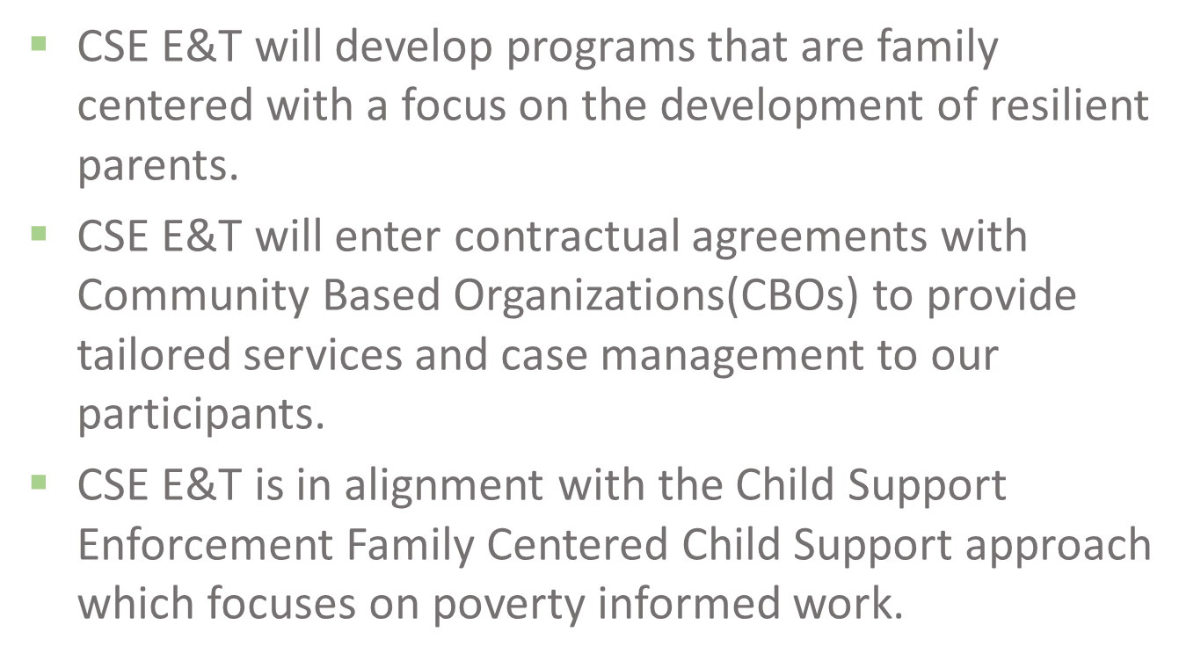
What is cse e&T?

Slide 5
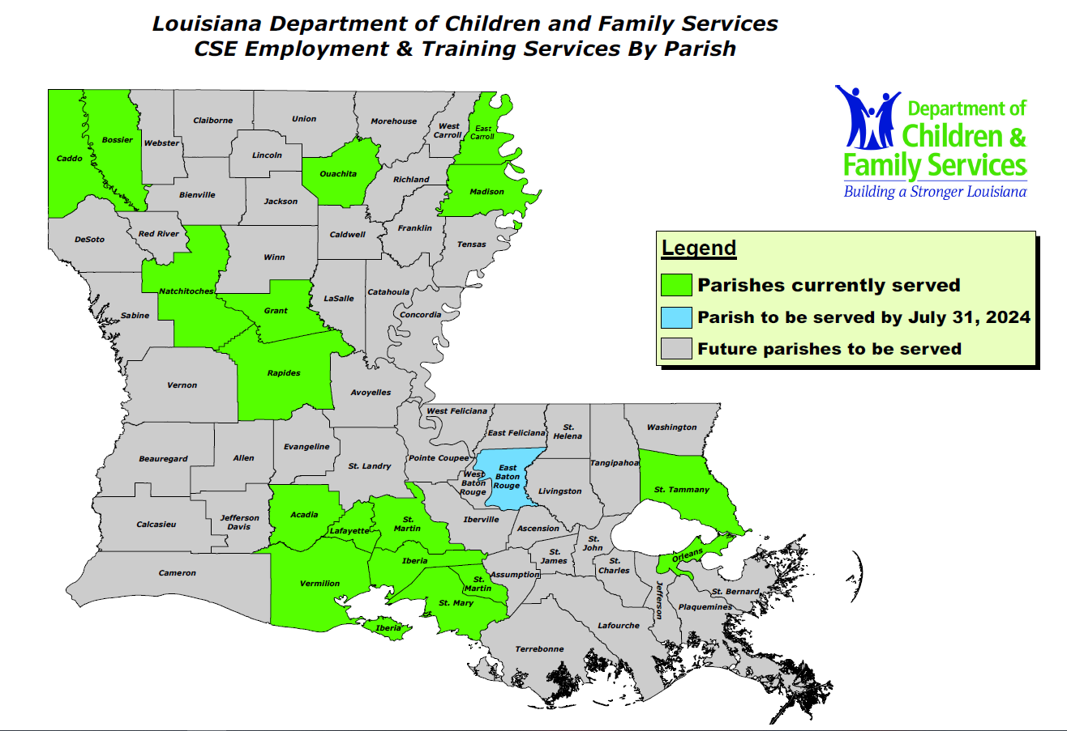
CSE E&T Coverage

Slide 6
Program progress
Current Program:
Goodwill of North Louisiana Expansion (GINLA)
Shreveport CSE: Caddo and Bossier Parish
Alexandria CSE: Rapides and Grant Parish
Monroe CSE: Ouachita Parish
Goodwill of Southeast Louisiana (GWSELA)
Amite CSE: St. Tammany Parish
NOVA Workforce Institute of Northeast Louisiana (NOVA)
Tallulah CSE: Madison and East Carroll Parish
Ben D. Johnson Legacy Workforce
Natchitoches CSE: Natchitoches Parish
Eckerd Connects
Lafayette CSE: Acadia, Lafayette, St. Martin, St. Mary, Vermillion & Iberia Parish
Total Community Action of New Orleans (TCA)
New Orleans CSE: Orleans Parish

Slide 7
Contracts in progress
The W Consulting Group w/CBO
Baton Rouge CSE: East Baton Rouge, East Feliciana, & West Feliciana Parish
Contracts Process Outline (6 phases):
CBO – Completing the SOW and Budget Template
WD Contracts – Contract Negotiations between WD & CBO
CSE Legal – CSE Legal and Director review and approval
DCFS Legal – DCFS Legal review and approval
DCFS Contracts – DCFS Contract Review and approval
OSP – OSP Review, approval and finalization

Slide 8
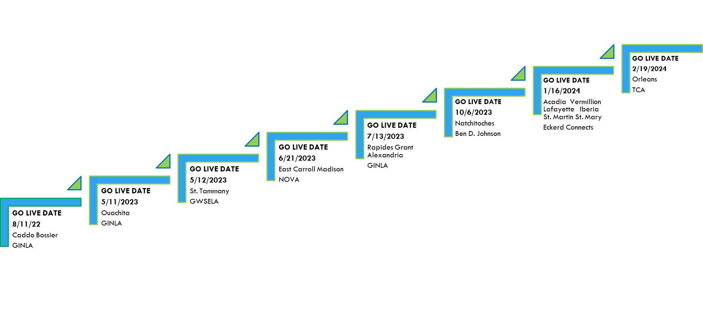
CSE E&T Program Timeline

Slide 9
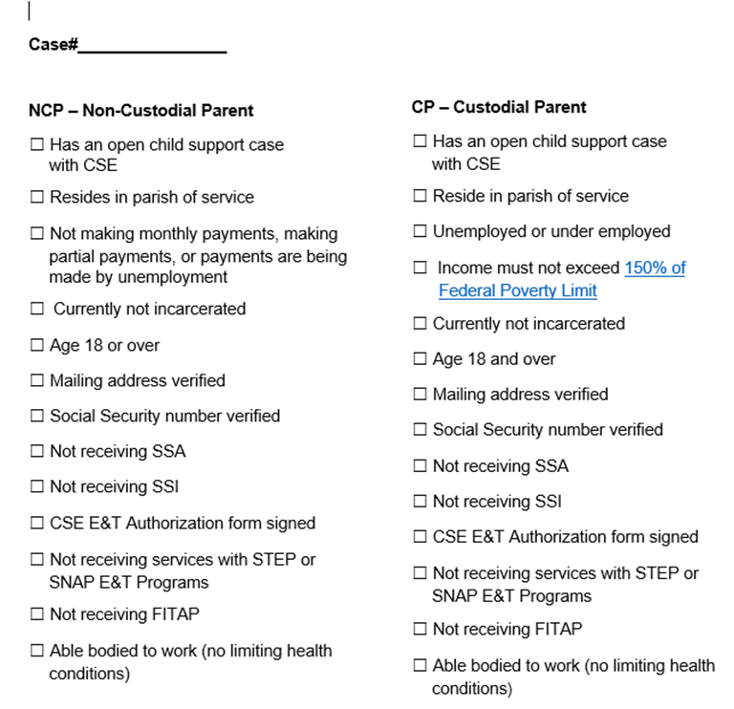
CSE E&T Criteria Form

Slide 10
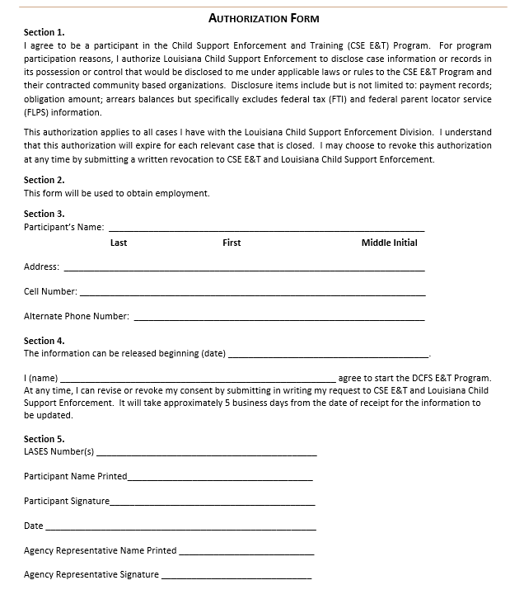
CSE E&T Authorization Form

Slide 11
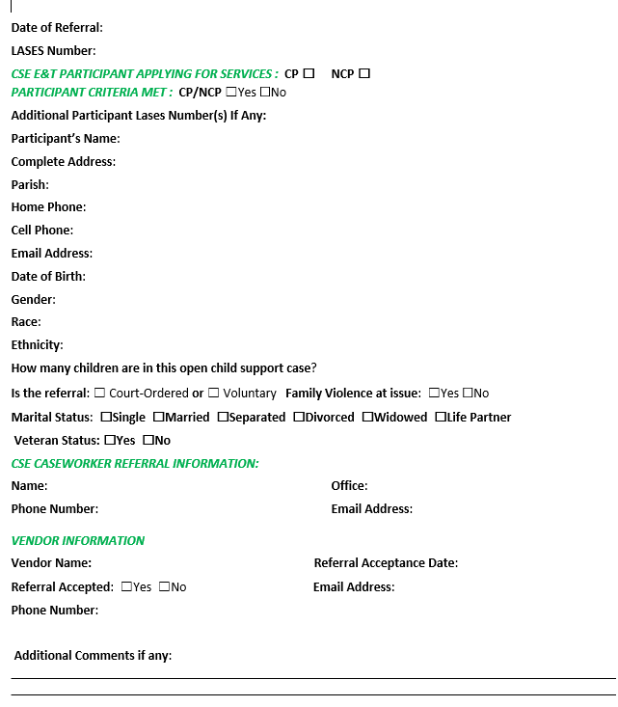
CSE E&T Referral Form

Slide 12
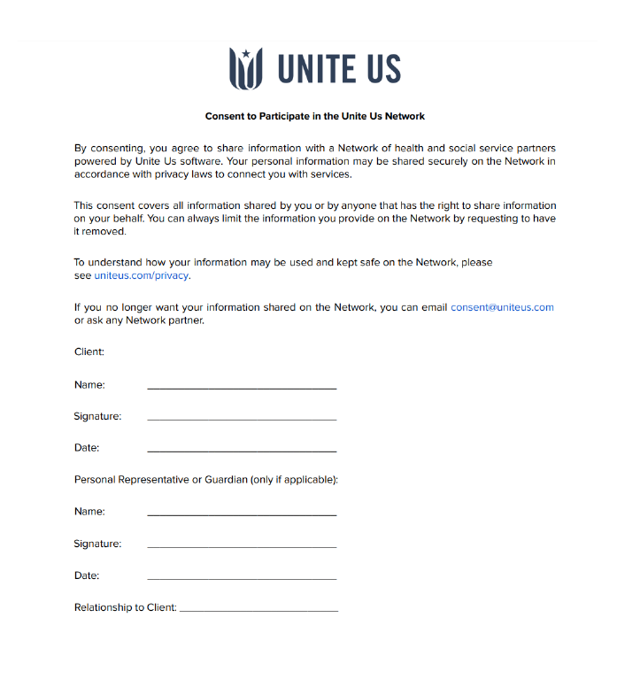
Unite Us Consent Form

Slide 13
Unite us
CSE E&T Consultants will input referrals into UNITE US.
The CSE E&T consultants do not receive notifications when referrals are received. CSE E&T has requested CSE to continue sending emails with documentation to our CSE E&T email address CSEEmployment&Training@LA.GOV.

Slide 14

NCP Flyer

Slide 15

CP Flyer

Slide 16
CSE Works
A system that was designed for CSE E&T to service participants. The system will allow both internal and external partners to schedule work assessment appointments, create impactful employment plans, enroll participants in training, track progress towards employment, and provide reporting.

Slide 17
CSE Works Overview
CSE WORKS has been added to Success Factors as a CPTP course.
The courses are listed as DCFS CSE E&T Training for Providers (WBT 1143) and DCFS CSE E&T Training for Workers (WBT 1144).
The following reports will be made available to the CSE Analyst: Participants by Enrollment Type & Status, Participants by Program Outcome, Child Support Obligation Report, Component Activity, Component Progress - Individual Rollup, Component Progress – Client Level, Educational Gains- Rollup, Employment and Training Retention Report.
What’s the newest change: CSE Analyst will be able to see client information.
As we continue to implement CSE E&T program statewide more employees and Community Based Organizations (CBO’s) will be provisioned/granted access.
It will be the CBO’s responsibility to enter participant’s data/information to the system.
CSE Analysts will have access to track the progress of the participants.
The System Administrators are Britney Davis and Armenda Sims.
Any errors and technical issues should be reported to the System Administrators.

Slide 18
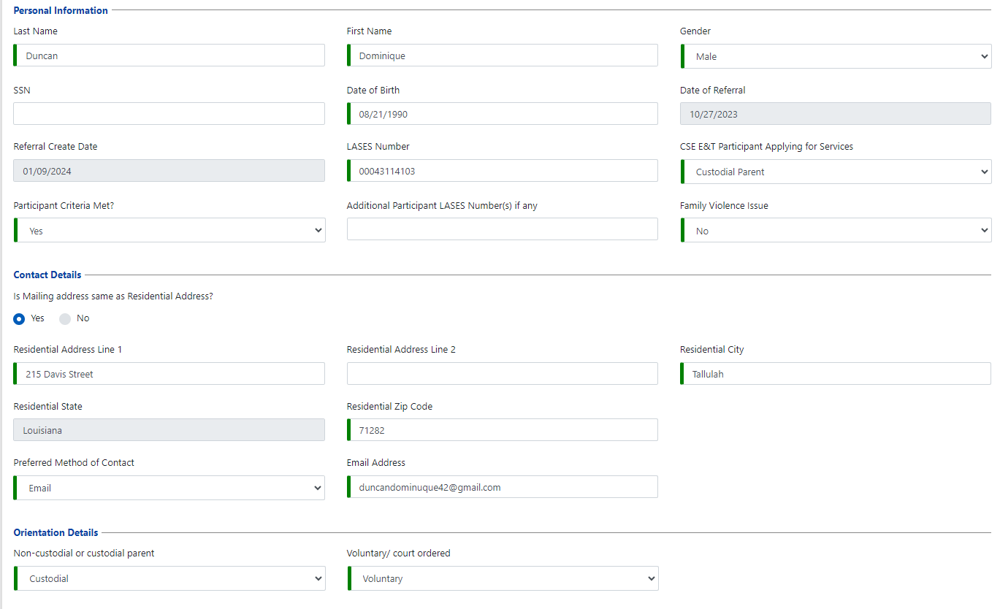
Client summary
Notes:
This is the information that the participant gives the CBO at their time of enrollment. It is also updated when the participant changes their information with the CBO. CSE may go here and check for information when they are unable to locate the participant. It also provides the information if the participant is enrolled voluntarily or court ordered.

Slide 19
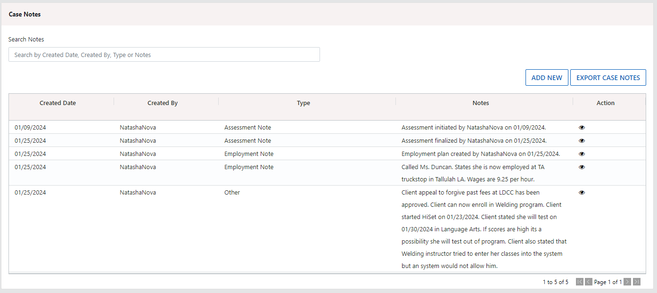
Case notes
Notes:
You may click on the Export Case Notes hyperlink. It will export to a Excel spreadsheet that can be printed to image to OnBase or take to court with the court report to advise of the current status.

Slide 20
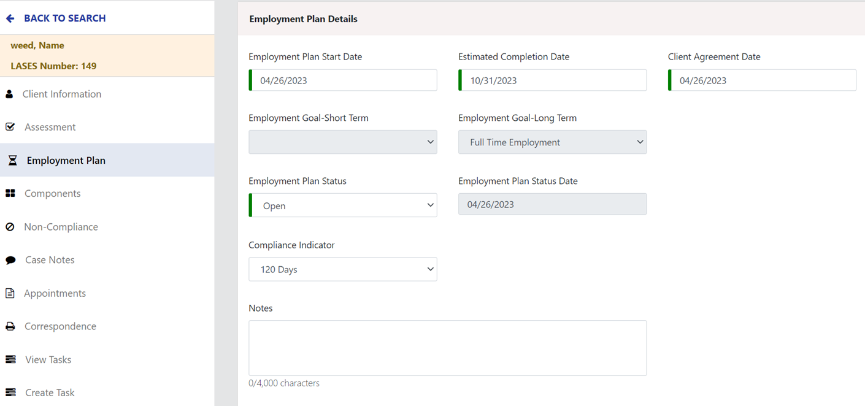
Employment plan
Notes:
CSE May see what the employment plan is and may sometimes see who the current employer is.

Slide 21
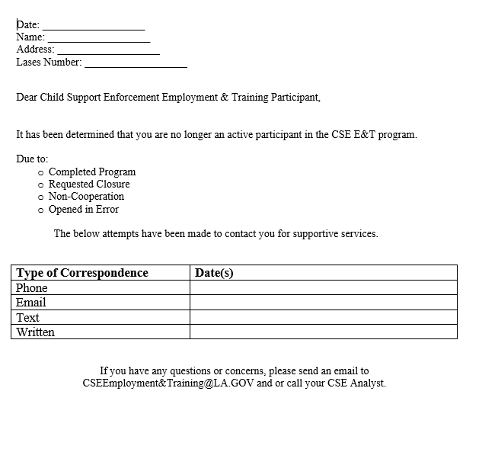
Termination Letter
Notes:
This will be forwarded to CSE after it has been received form the CBO listing the reason that the participant has been terminated from the program. List the reasons that the participant may be terminated and the case is closed.

Slide 22
CSE E&T statistics Update
Referrals to Date:2022
August – 5 referrals all NCPs
September – 6 NCPs referrals & 1 CP referral
October – 8 NCPs referrals & 1 CP referral
November – 10 referrals all NCPs
December – 18 referrals all NCPs
2023
January -19 referrals all NCPs
February- 10 NCPs referrals 1 CP referral
March- 11 referral all NCPs
April- 6 referrals all NCPS
May- 27 NCPs and 2 CP referrals
June- 20 NCPs and 1 CP referral
July- 30 NCPs and 3 CPs referrals
August - 45 NCPs and 10 CPs referrals
Sept- 33 NCPs and 8 CPs referrals
October- 25 NCPs and 7 CPs
November 37 NCPs and 4 CPs
December 11 NCPs 4 CPs

Slide 23
CSE E&T Statistics Update continued
2024
January 33NCPs 7CPs
February 16NCPs 2CPs
Voluntary –349 / Court Mandated - 83
Total: 432 referrals year to date

Slide 24
CSE E&T Statistics Update continued
# of Clients Placed in Initial Job - 8 - January
Average Quarterly Wage - $13.22
Cases Closed- 187 due to non-compliance
The program has assisted 18 participants with part-time employment and 50 with full-time employment. 22 participants have had replacement jobs since being in the program.
Notes:
These stats are from the end of January. February is pending. The quarter months are November, December, and January.

Slide 25
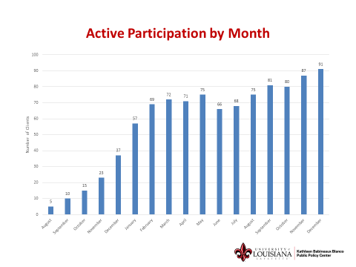
Blanco Info

Slide 26
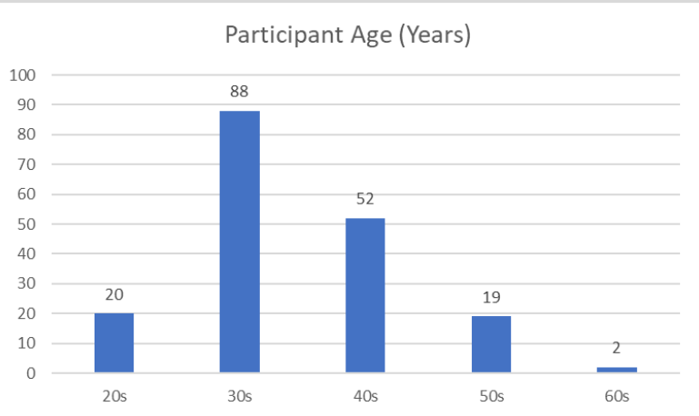
Blanco Info

Slide 27
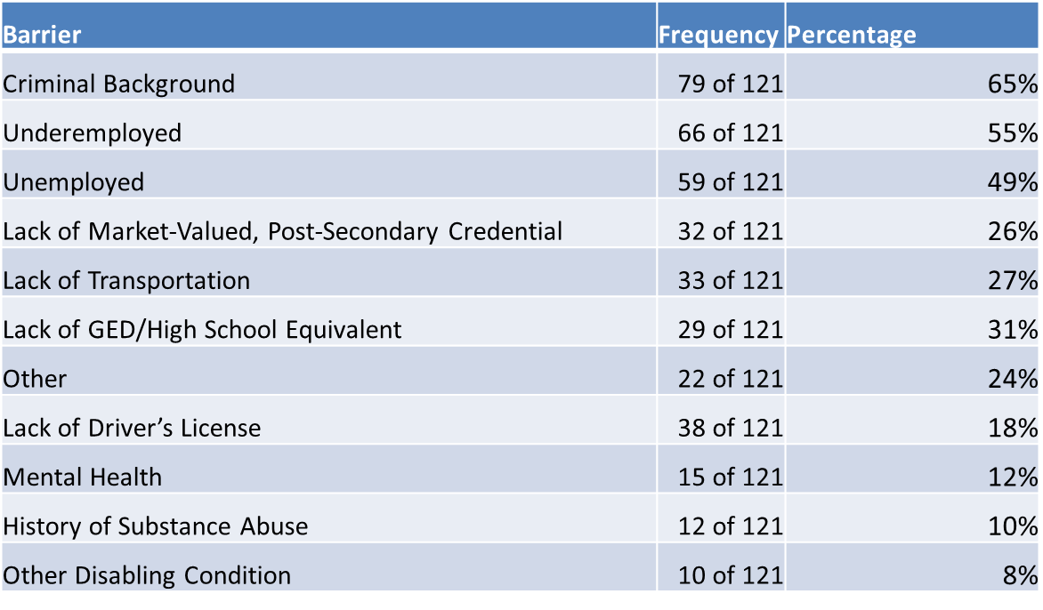
Blanco Info
Notes:
These are the barriers that our participants have encountered.

Slide 28
CSE E&T Workflow
CSE reviews case
Determine eligibility
Obtain parent’s authorization
Complete all required forms.
Open, complete forms in Unite Us
CSE Analyst reviews the facts of the child support case
CSE Analyst assess whether the parent meets program eligibility using the Criteria Form.
CSE Analyst discusses the program and asks the parent to complete and sign the Authorization Form.
CSE Analyst completes Referral Form and Unite Us Consent Forms for the Custodial Parent or Non-Custodial Parent.
CSE E&T Consultant opens and completes the referral in Unite Us.
Email forms to CSE E&T, upload to OnBase, and update LASES
CSE emails all 4 forms (Criteria, Authorization, Referral, & Unite Us Consent) to CSE E&T at CSEEmployment&Training@LA.GOV and uploads all 4 forms to Onbase. Update CSE E&T indicator in LASES.

Slide 29
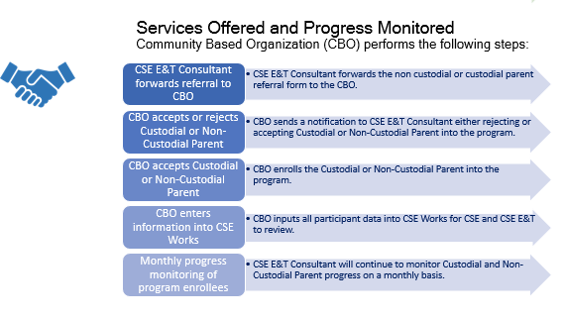
CBO Workflow

Slide 30
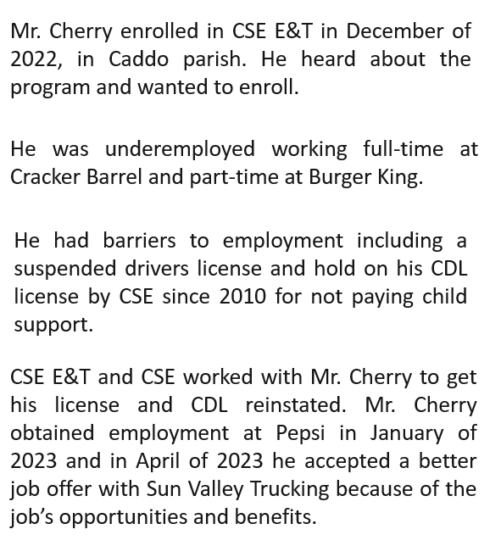
CSE E&T Success Stories

Slide 31
CSE E&T Success Stories
Mr. Cherry completed our program on 01/09/2024 and his job retention and payment record is a testament to our program.
Mr. Cherry says that he is a fan of our program and he is very proud of his accomplishments. We are proud of Mr. Cherry’s accomplishments too.
Mr. Cherry is now successfully paying his child support and arrears.

Slide 32
CSE E&T Success Stories
Judge Oppenheim along with ADA Amanda Trosclair was able to come together to celebrate our participants who are enrolled in the Goodwill CSE E&T Program. Yesterday We was able to hear the participant’s success stories and how much the program has impacted their lives in a positive direction.
I would like to shine a bright light on Ms. Gretchen and Ms. Michelle from Goodwill. I always hear positive stories about how professional they are and the dedicated and care that they give to each and every participant. I truly appreciate the both of them. I am looking forward to attending more celebrations and continuing our journey in assisting the community St. Tammany.

Slide 33
Goals for 2024
Enroll More Participants
Expand in the State
Building Partnerships with CBOs

Slide 34
PRESENTER CONTACT INFORMATION
Brandy Williams, CSE E&T Manager Brandy.Williams.DCFS@LA.GOV
Britney Davis, CSE E&T Consultant Britney.Davis.DCFS@LA.GOV

